Slide 1

Water Systems in Integrated Human-Earth System Models Neal Graham, Ph.D Joint Global Change Research Institute
PLCY-798K
Integrated Human-Earth System Modeling and Policy Assessment
February 22, 2023
Credit to Tom Wild for slides

Slide 2
Today’s Topics
Water Demand
How much water do humans use, where, and for what purposes?
Water Supply
How much water is sustainably available, where, and in what forms?
How will climate change affect this supply?
Approach to Representing Water in Integrated Models
Why and how is water accounted for?
As an example, how does GCAM model water?
Exciting Science Questions Integrated Models are Exploring
What key insights have emerged?
What questions remain unanswered?

Slide 3
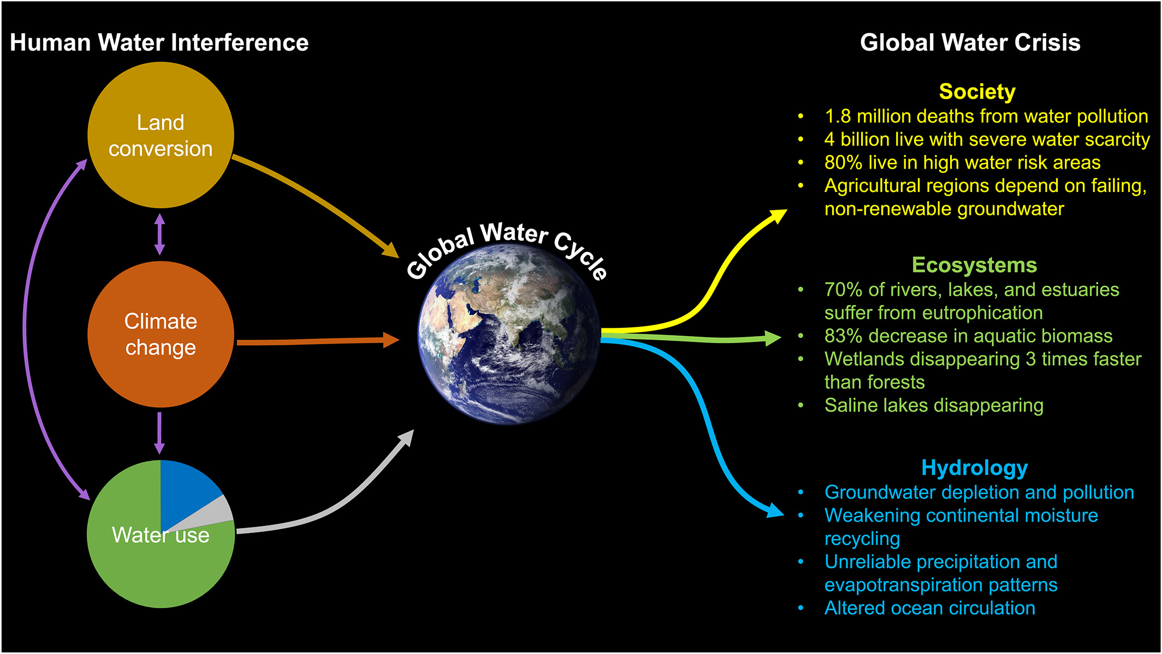
There is a Global Water Crisis, and Humans are Causing it
Source: Abbott et al. (2019)

Slide 4
Water Demand
How much water do humans use, where, and for what purposes?

Slide 5
First, Some Terminology
Water withdrawal (i.e., usage, demand): amount of fresh water taken from a water body for purposes of satisfying some human purpose (energy, domestic, irrigation, etc.)
Total Water Withdrawal: sum of water demands across all sectors (agriculture, industry, municipal)
Water consumption: amount of water withdrawal that is not returned to the original source and is no longer available for reuse (e.g., consumed through evaporation or incorporated into products or waste materials)
Water supply: used loosely to mean a lot of different things. In modeling lingo, demand=supply to clear markets, the same as it does for energy or land. Can also be used to indicate “availability”. Supply can come from surface water (lakes, river, reservoirs), groundwater (renewable or fossil), desalination, gray water “reuse”, etc.

Slide 6
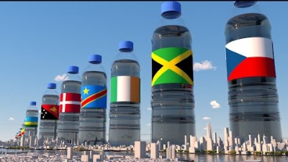
So, how much water do countries use?

Slide 7
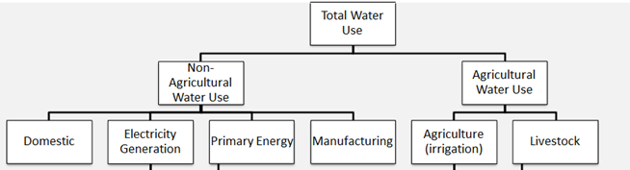
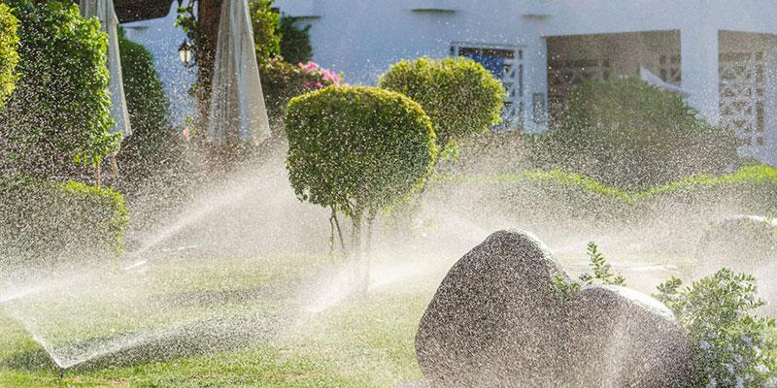
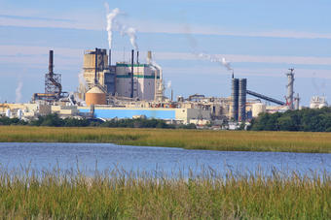

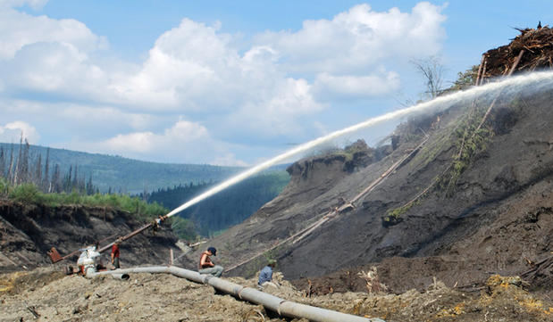
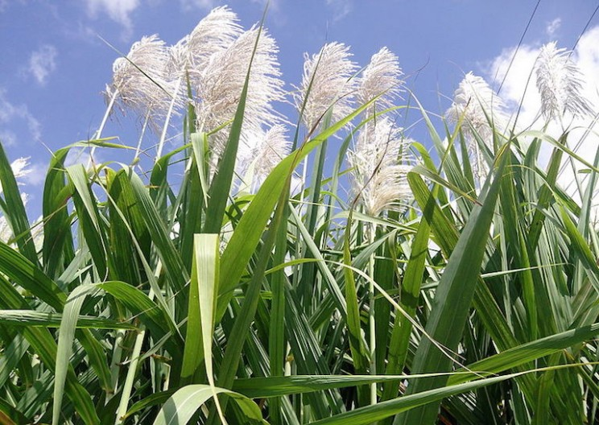
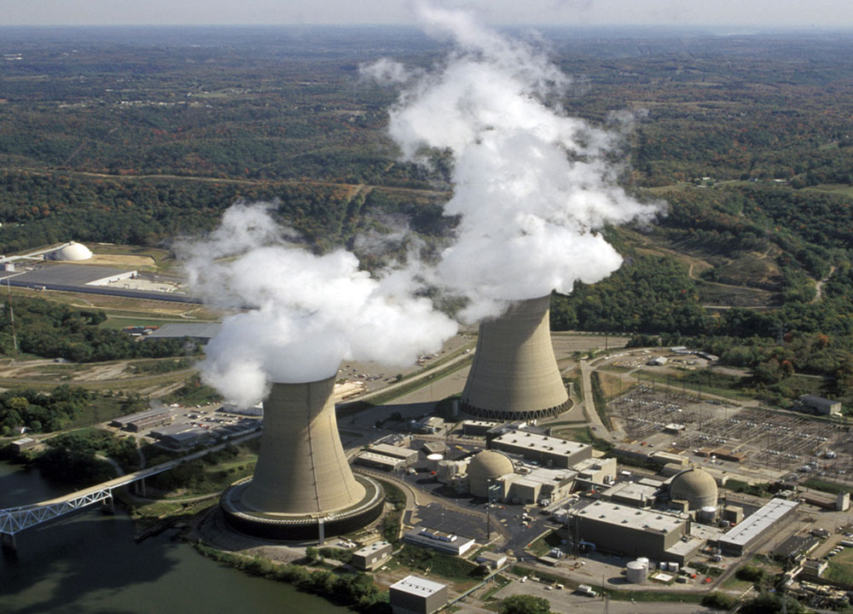
Water is a Critical Input to the Agriculture, Domestic, and Industrial Sectors

Slide 8


Future water usage in any region is complex to project, being tied to the evolution of future Ag. commodities trade dynamics
Virtual Water
Virtual water trade – Amount of water embedded in commodity production that is then traded in the global market (Allen 1998)
Importing is often driven by local unmet demands as a result of:
Insufficient water supply
Insufficient growing capacity (land or climate)
Cost
Adopted and modified from: watercalculator.org
Soil moisture and transpiration
consumed in crop growth
Blue = fresh surface runoff and
groundwater consumed in crop growth

Slide 9
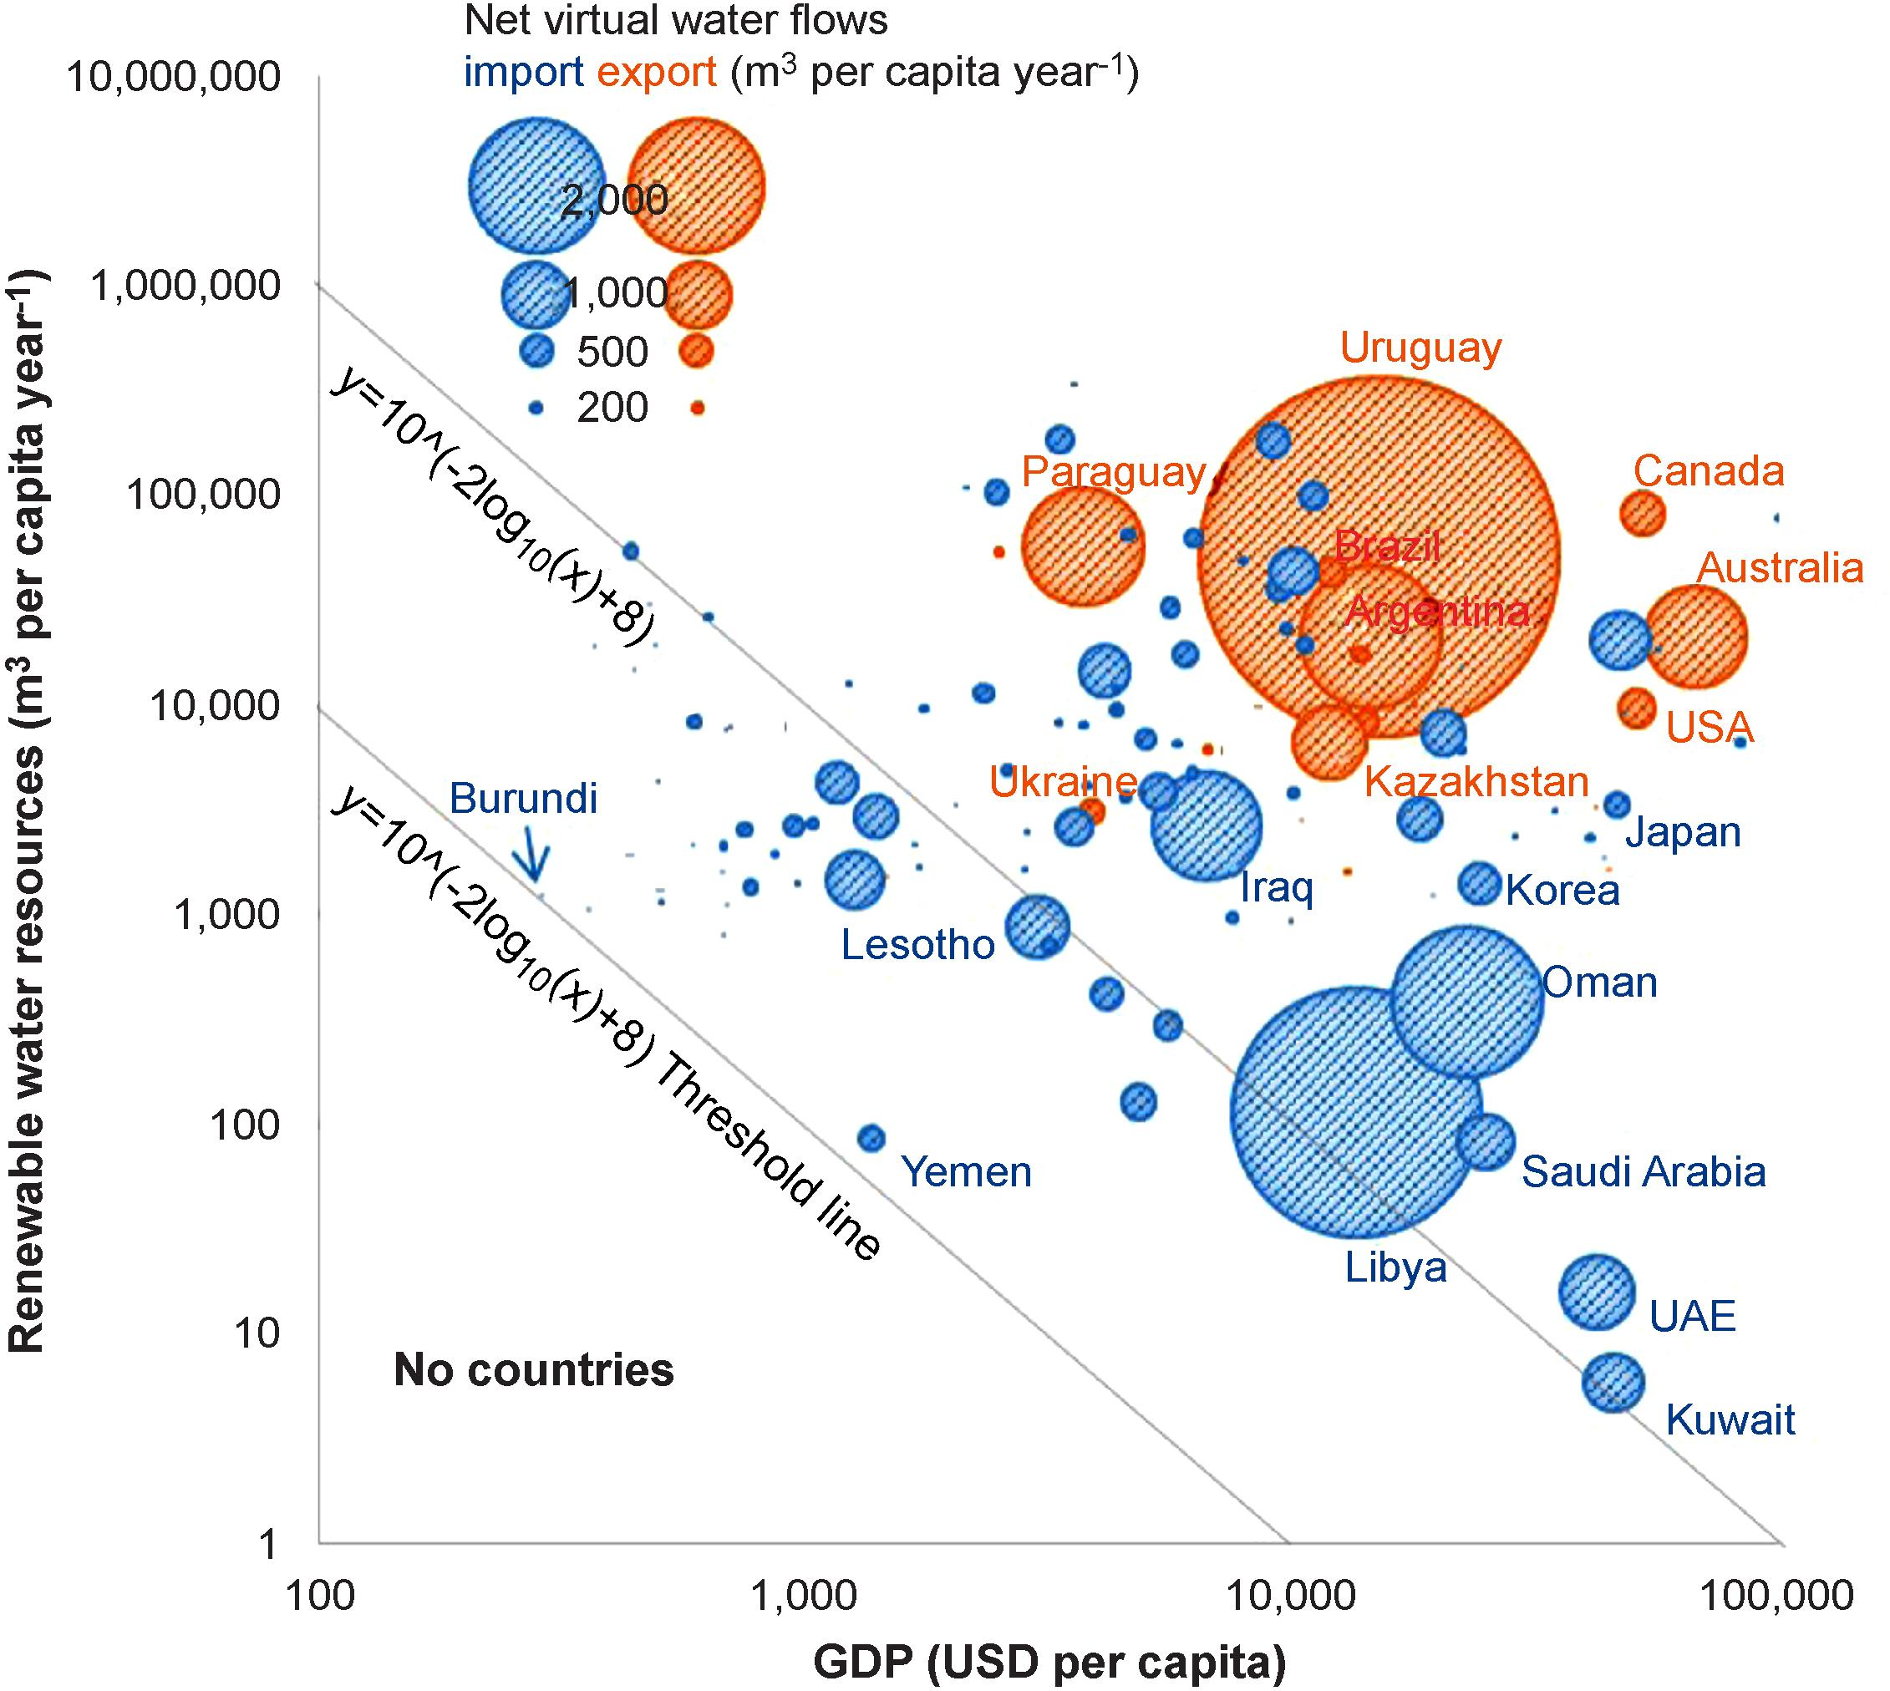
Future water usage in any region is complex to project, being tied to the evolution of future Ag. commodities trade dynamics
Integrated Human-Earth System Models like GCAM are uniquely positioned to deal with regional trade
Source: Oki et al 2017. Economic aspects of virtual water trade. ERL.

Slide 10
Water is a Critical Input to the Agriculture, Domestic, and Industrial Sectors

Slide 11

Thermoelectric power plants require cooling
Once-through cooling technology requires a lot of water “withdrawal”, with some “consumption”
“Thermonuclear” includes coal, gas, oil, nuclear, geothermal
Thermal discharge from power plants affects aquatic ecosystems
Thermoelectric
Power Plant
consumption
withdrawal
courtesy of Ashlynn Stillwell, UIUC
aquatic ecosystem impacts

Slide 12








Thermoelectric power plants require cooling
Recirculating cooling technology requires much less water “withdrawal”, but high “consumption”
Water Consumption
Turbine
Generator
Boiler
Cooling Tower
courtesy of Ashlynn Stillwell, UIUC
Water Withdrawal

Slide 13
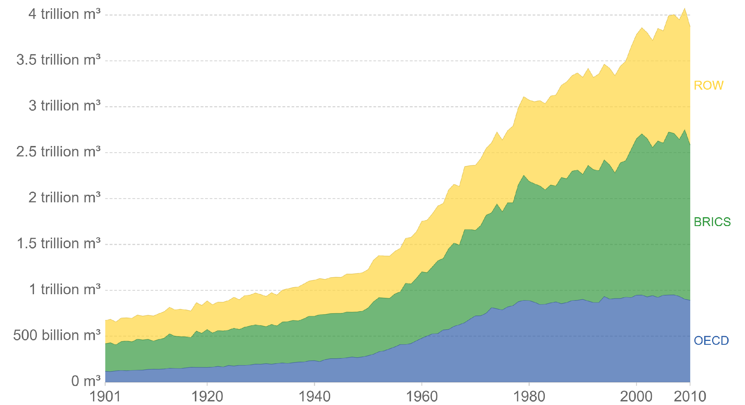
Agriculture Sector is the Dominant Water User Historically, with Largest Demands in developing economies
Global water withdrawals by sector
Global water withdrawals by region
4 500
4 000
3 500
3 000
km³/yr
2 500
2 000
1 500
1 000
500
0
1900
1910
1920
1930
1940
1950
1960
1970
1980
1990
2000
2010
Reservoirs* Municipalities Industries Agriculture
Year
Note: *Evaporation from artificial lakes.
Source: AQUASTAT (2010).
How will these demands evolve into the future? What sources of water will “supply” these demands in the future? Integrated Models like GCAM are useful for addressing such questions.

Slide 14
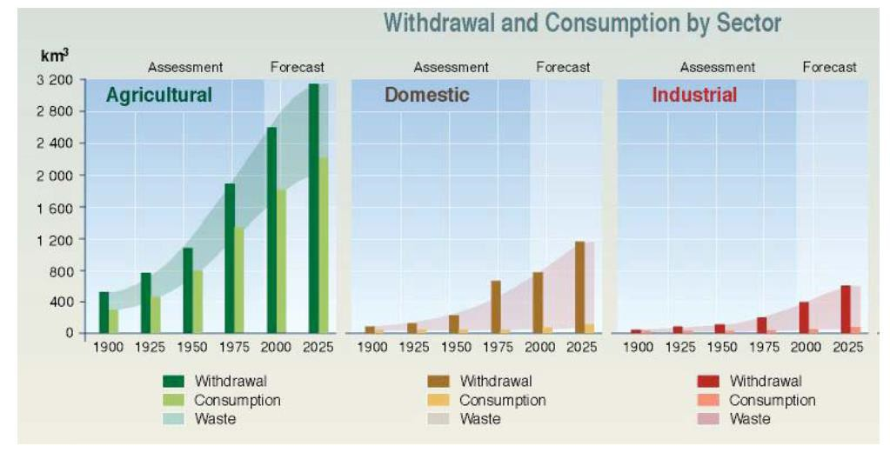
Water is a Critical Input to Economic Growth Across the Agriculture, Domestic, and Industrial Sectors
Green water: component of agricultural withdrawal supplied by soil moisture
Blue water = component of water withdrawal supplied by “direct transport” (irrigation)

Slide 15
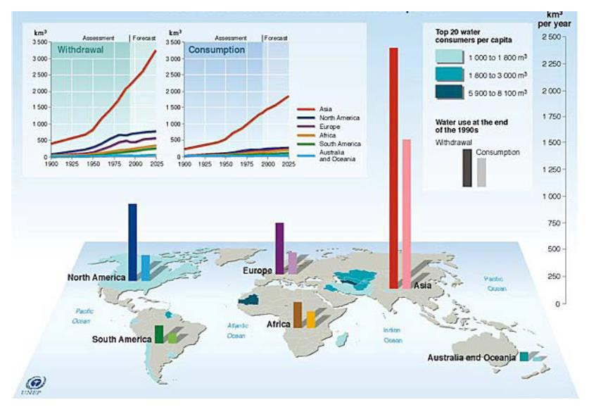
Global water use varies significantly by region

Slide 16
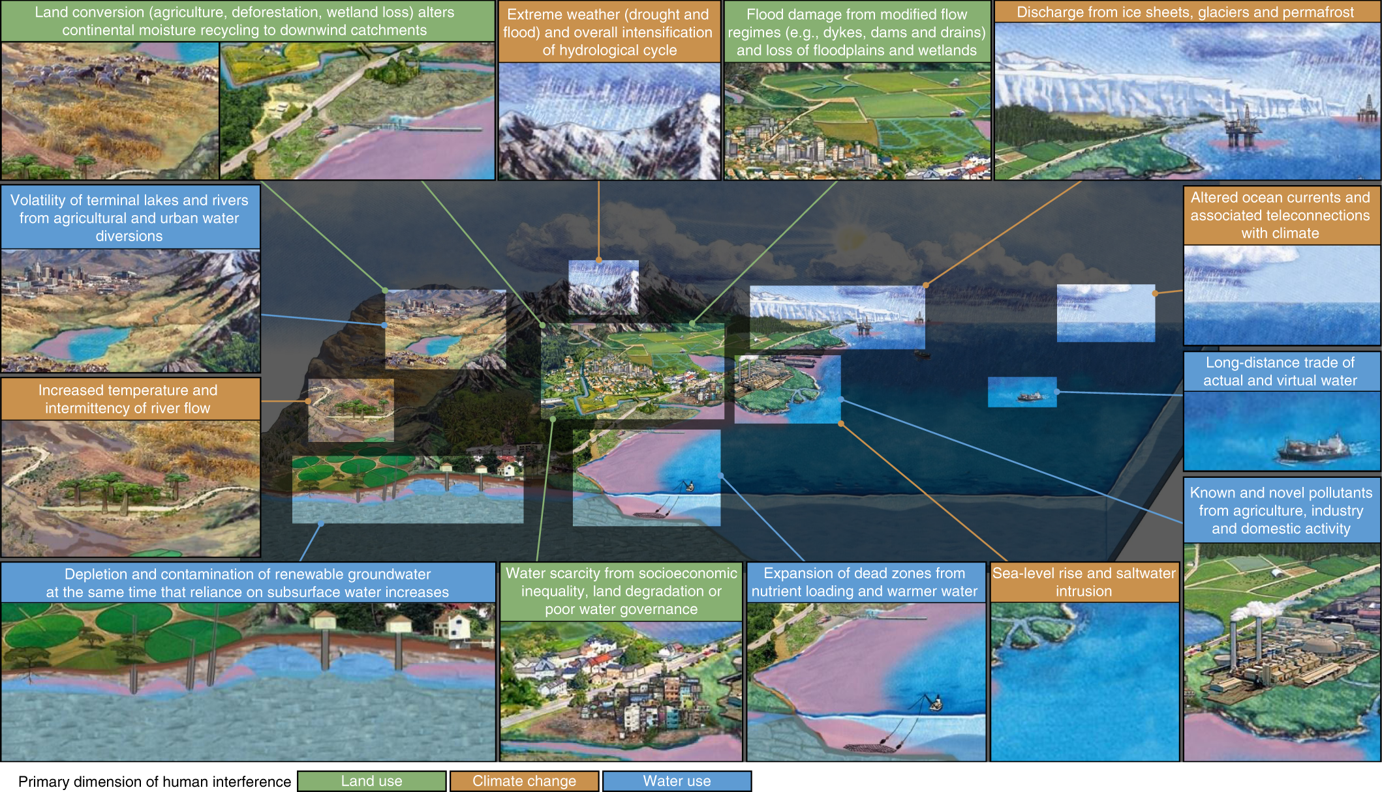
How are humans modifying the water cycle via water use?
Source: Abbott et al. (2019)

Slide 17
Water Supply
How much water is (sustainably) available, where, and in what forms?
How will climate change affect this supply?

Slide 18
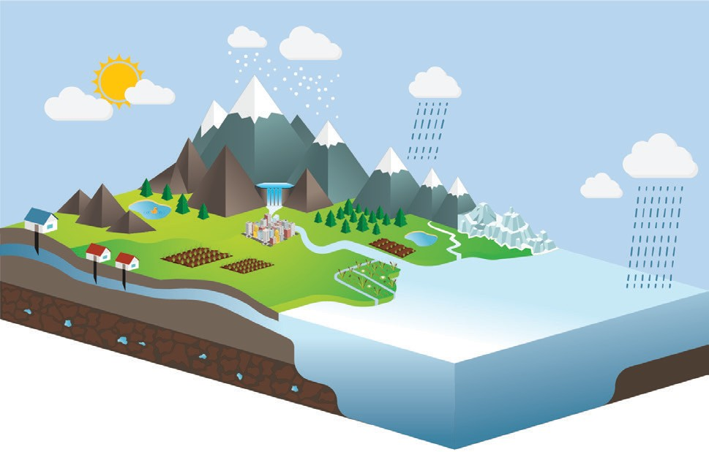
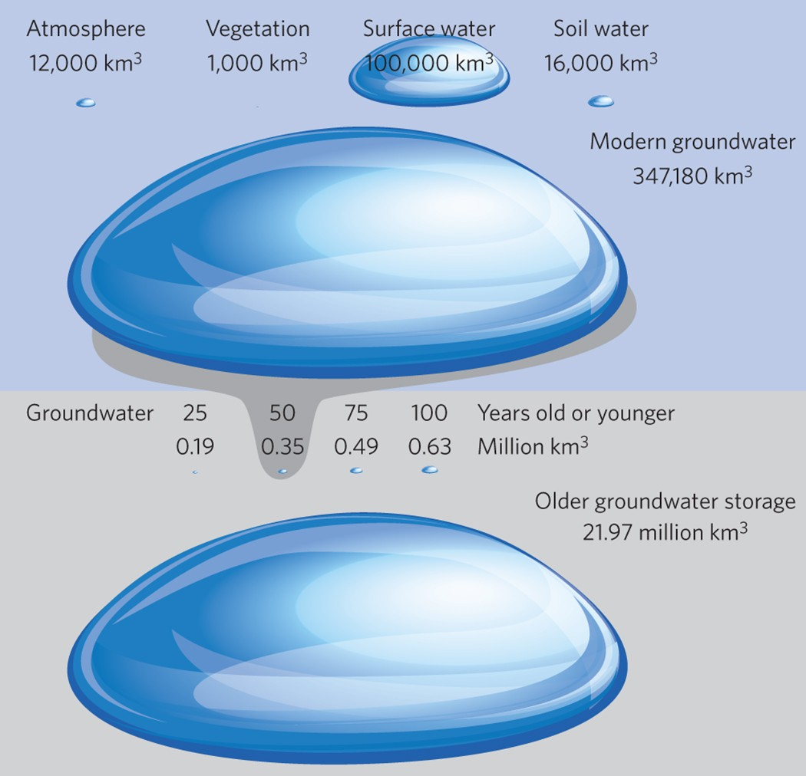
The Global Water Cycle
Water Stocks (i.e., Pools)
a) Water pools
“Active”
Atmosphere over land 3.0 ± 10%
Snowpack (annual maximum) 2.7 ± 20%
Permafrost 210 ± 100%
Reservoirs 11 ± 40%
Atmosphere over ocean 10 ± 20%
Saline lakes 95 ± 10%
Ice sheets and glaciers 26 000 ± 10%
Biological water 0.94 ± 30%
Soil moisture 54 ± 90%
Rivers 1.9 ± 20%
Fresh lakes 110 ± 20%
Renewable groundwater 630 ± 70%
Wetlands 14 ± 20%
Surface ocean 130 000 ± 30%
“Groundwater”
Non-renewable groundwater 22 000 ± 80%
Deep ocean 1 200 000 ± 8%
Source: WWDR (2020)
Source: Gleeson et al. (2016)
What are the largest stocks of available freshewater for human use?
Groundwater (GW) provides a huge reserve. “Modern” groundwater = 3x SW; Fossil GW=220x SW. Though fossil GW is not “sustainable, can be expensive to pump, and is really of unknown quantity.

Slide 19

The Global Water Cycle
Water Stocks (i.e., Pools)
Water Flows (i.e., Fluxes)
a) Water pools
b) Water fluxes
Total human water appropriation (green + blue + grey) 24 ± 20%
Land precipitation 110 ± 10%
Land evapotranspiration 69 ± 10%
Atmosphere over land 3.0 ± 10%
Snowpack (annual maximum) 2.7 ± 20%
Permafrost 210 ± 100%
Reservoirs 11 ± 40%
Atmosphere over ocean 10 ± 20%
Endorheic discharge 0.8 ± 30%
Ocean to land atmospheric flux 46 ± 20%
Saline lakes 95 ± 10%
Ice sheets and glaciers 26 000 ± 10%
Biological water 0.94 ± 30%
Green water use 19 ± 20%
Ocean precipitation 380 ± 20%
Rivers 1.9 ± 20%
Fresh lakes 110 ± 20%
Groundwater recharge 13 ± 50%
Soil moisture 54 ± 90%
Blue water use 4.0 ± 30%
Land ice discharge 3.1 ± 40%
Wetlands 14 ± 20%
Grey water use (pollution) 1.4 ± 40%
River discharge to ocean 46 ± 10%
Renewable groundwater 630 ± 70%
Interbasin ocean circulation 5 000 ± 20%
Ocean evaporation 420 ± 20%
Surface ocean 130 000 ± 30%
Groundwater discharge to ocean 4.5 ± 70%
Non-renewable groundwater 22 000 ± 80%
Deep ocean 1 200 000 ± 8%
Vertical ocean circulation 2 100 ± 30%
Source: WWDR (2020)
It is no longer possible to understand the distribution of water quantity and quality on Earth without considering human activity.
Human water use (fluxes) are separated into green (78%), blue (16%), and grey (6%) water use

Slide 20
The Global Water Cycle
Water Stocks (i.e., Pools)
Water Flows (i.e., Fluxes)
a) Water pools
b) Water fluxes
Total human water appropriation (green + blue + grey) 24 ± 20%
Land precipitation 110 ± 10%
Land evapotranspiration 69 ± 10%
Atmosphere over land 3.0 ± 10%
Snowpack (annual maximum) 2.7 ± 20%
Permafrost 210 ± 100%
Reservoirs 11 ± 40%
Atmosphere over ocean 10 ± 20%
Endorheic discharge 0.8 ± 30%
Ocean to land atmospheric flux 46 ± 20%
Saline lakes 95 ± 10%
Ice sheets and glaciers 26 000 ± 10%
Biological water 0.94 ± 30%
Green water use 19 ± 20%
Ocean precipitation 380 ± 20%
Rivers 1.9 ± 20%
Fresh lakes 110 ± 20%
Groundwater recharge 13 ± 50%
Soil moisture 54 ± 90%
Blue water use 4.0 ± 30%
Land ice discharge 3.1 ± 40%
Wetlands 14 ± 20%
Grey water use (pollution) 1.4 ± 40%
River discharge to ocean 46 ± 10%
Renewable groundwater 630 ± 70%
Interbasin ocean circulation 5 000 ± 20%
Ocean evaporation 420 ± 20%
Surface ocean 130 000 ± 30%
Groundwater discharge to ocean 4.5 ± 70%
Non-renewable groundwater 22 000 ± 80%
Deep ocean 1 200 000 ± 8%
Vertical ocean circulation 2 100 ± 30%
Source: WWDR (2020)
How much of this water can we sustainably use, and in which categories?
46 10³ km³/yr

Slide 21
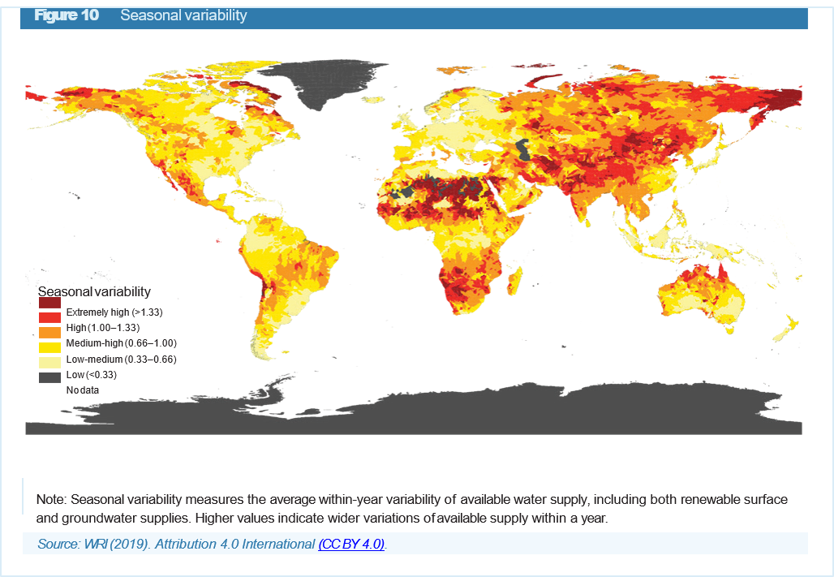
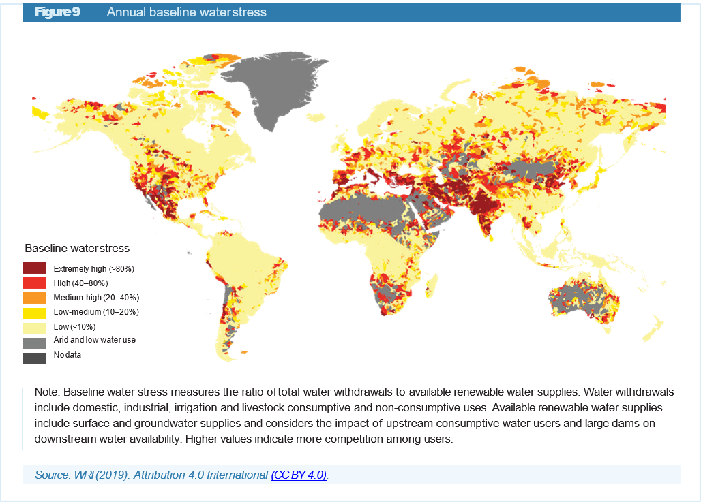
Spatiotemporal distribution of water supply and demand
Seasonal Supply Variability
Water Stress
Source: WRI (2019)
If we have 46000 km3/yr available, and we only use 4000 km3/yr, what’s the problem?
Uneven spatiotemporal distribution of water

Slide 22
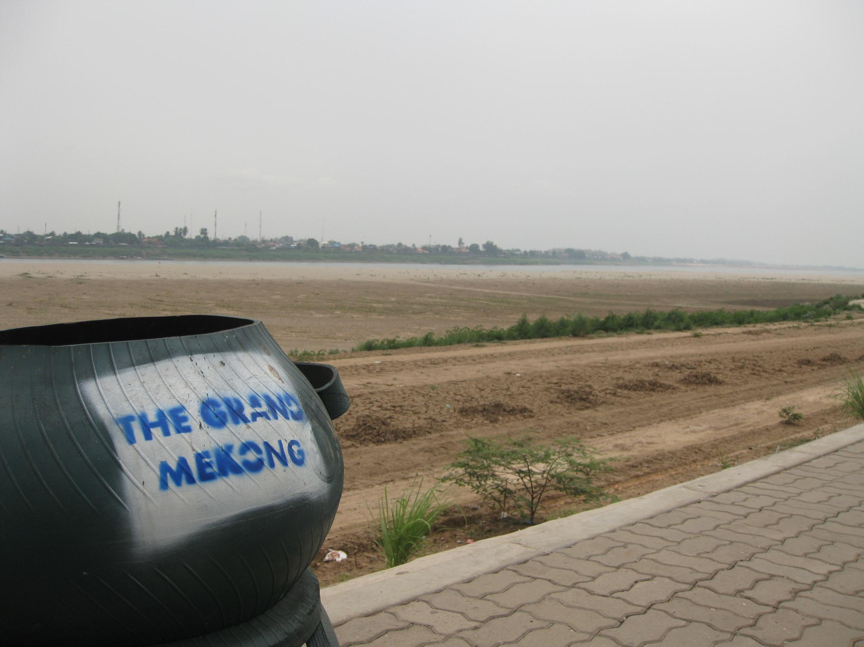
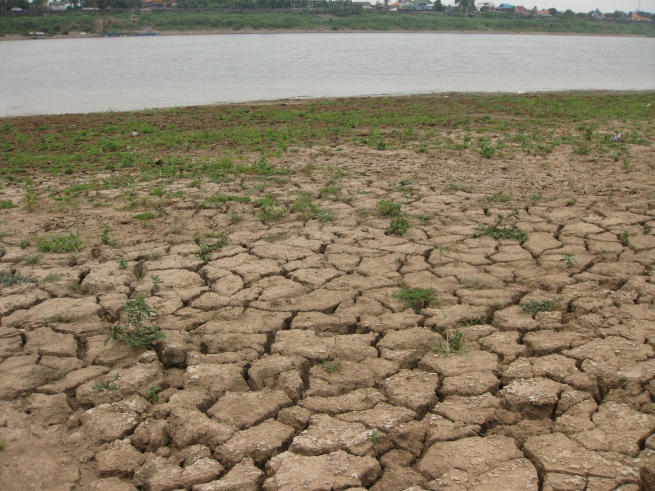
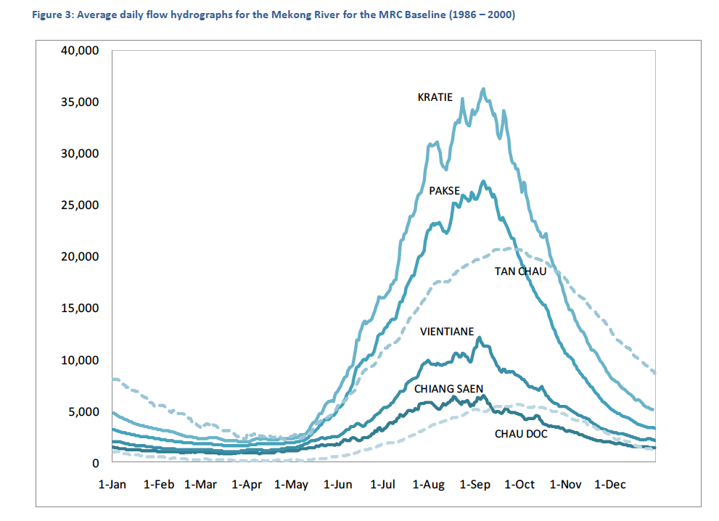
Dry Season: Vientiane, Laos

Slide 23

Background: Hydrology
Wet Season: Vientiane, Laos

Slide 24
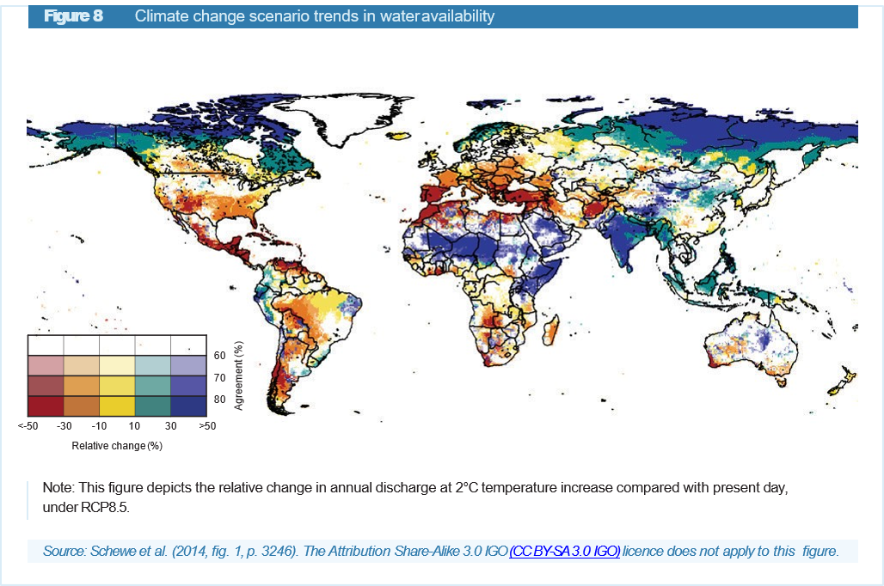
How will Climate Change Impact Water Supply?
An accelerated water cycle will increase rainfall and thus renewable freshwater flux. But there will be winners and losers. Some regions will see more and some less water on average.
There is huge uncertainty—Earth System Models (ESMs) only agree for about 1/3 of land area.
This is a big challenge for IAMs, because they have not been built to consider extreme events

Slide 25
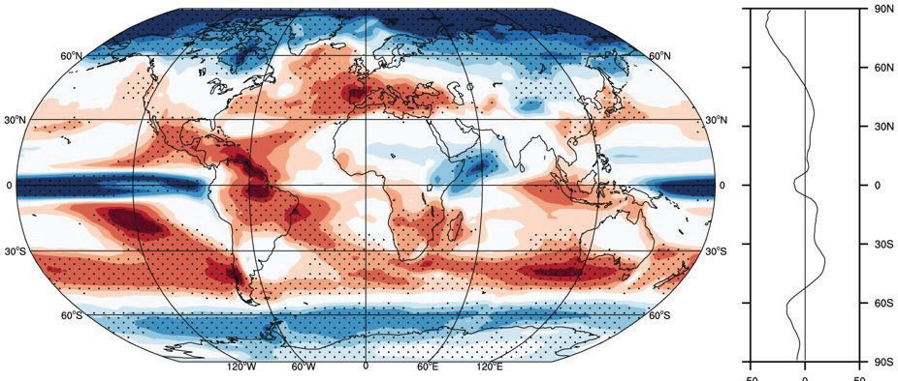
How will Climate Change Impact Water Supply?
Figure 6
CMIP5 multi-model ensemble average mean change in frequency of dry days (days/year) by 2060–2089, relative to the historical period 1960–1989, using the RCP8.5 forcing scenario
One thing ESMs do agree on is projected increasing frequency and magnitude of extreme events such as heatwaves, droughts, unprecedented rainfalls, thunderstorms and storm surge events.
This modeling requires assumptions about emissions that come from models like GCAM, but is otherwise typically disconnected from these models, in the sense that Integrated Human-Earth System Models have not traditionally explicitly considered climate feedbacks.
(days/year)
-30
-20
-10
0
10
20
30
Note: Stippling indicates areas where at least 70% of the models agree on the sign of the change. Graph to the right: zonal mean values.
Source: Polade et al. (2014, fig. 2).

Slide 26
How are humans modifying the water cycle via climate change?
Source: Abbott et al. (2019)

Slide 27
Approach to Representing Water in Integrated Human-Earth System Models
Why and How is Water Accounted for?
As an example, how does GCAM model water?

Slide 28
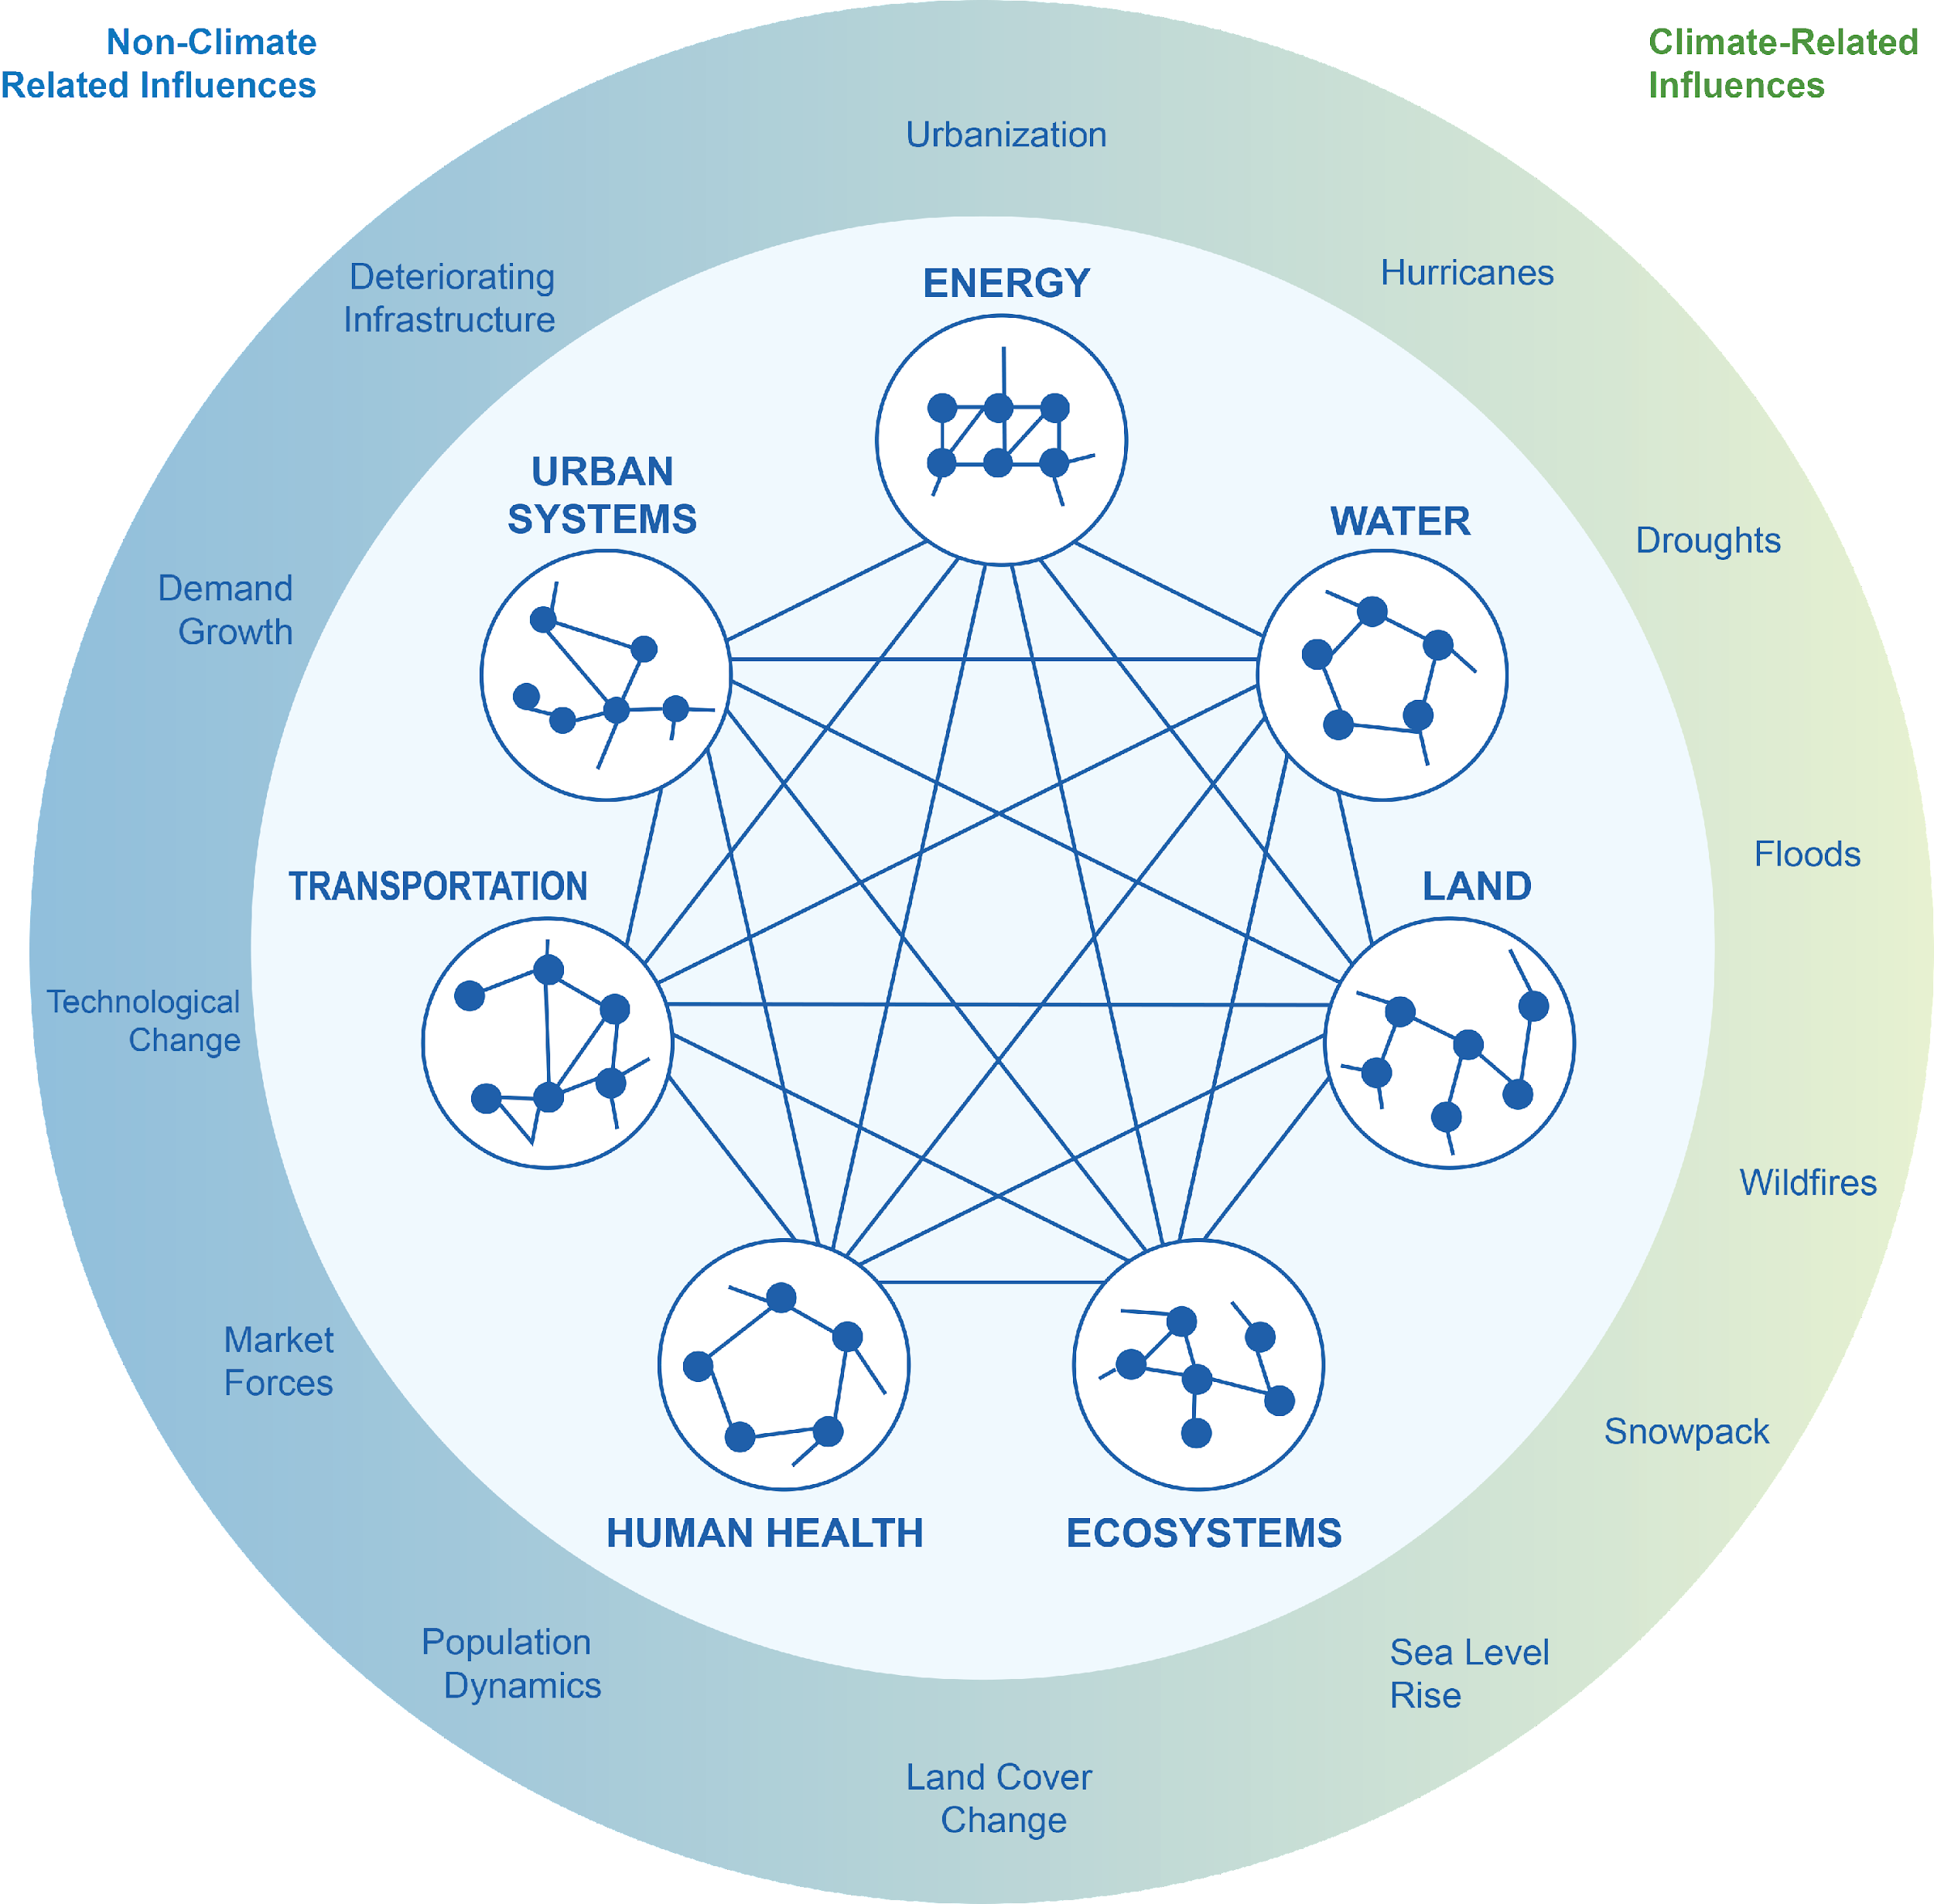
Why do we include water?
The world we live in is a complex web of natural, built, and social systems (i.e., coupled human-earth systems)
Energy, water, land and other system elements are highly interconnected
Multiple climate and non-climate factors influence the way these systems behave and interact with one another
The evolution of energy, water, and land in turn influence climate
Source: Clarke et al. (2018)

Slide 29
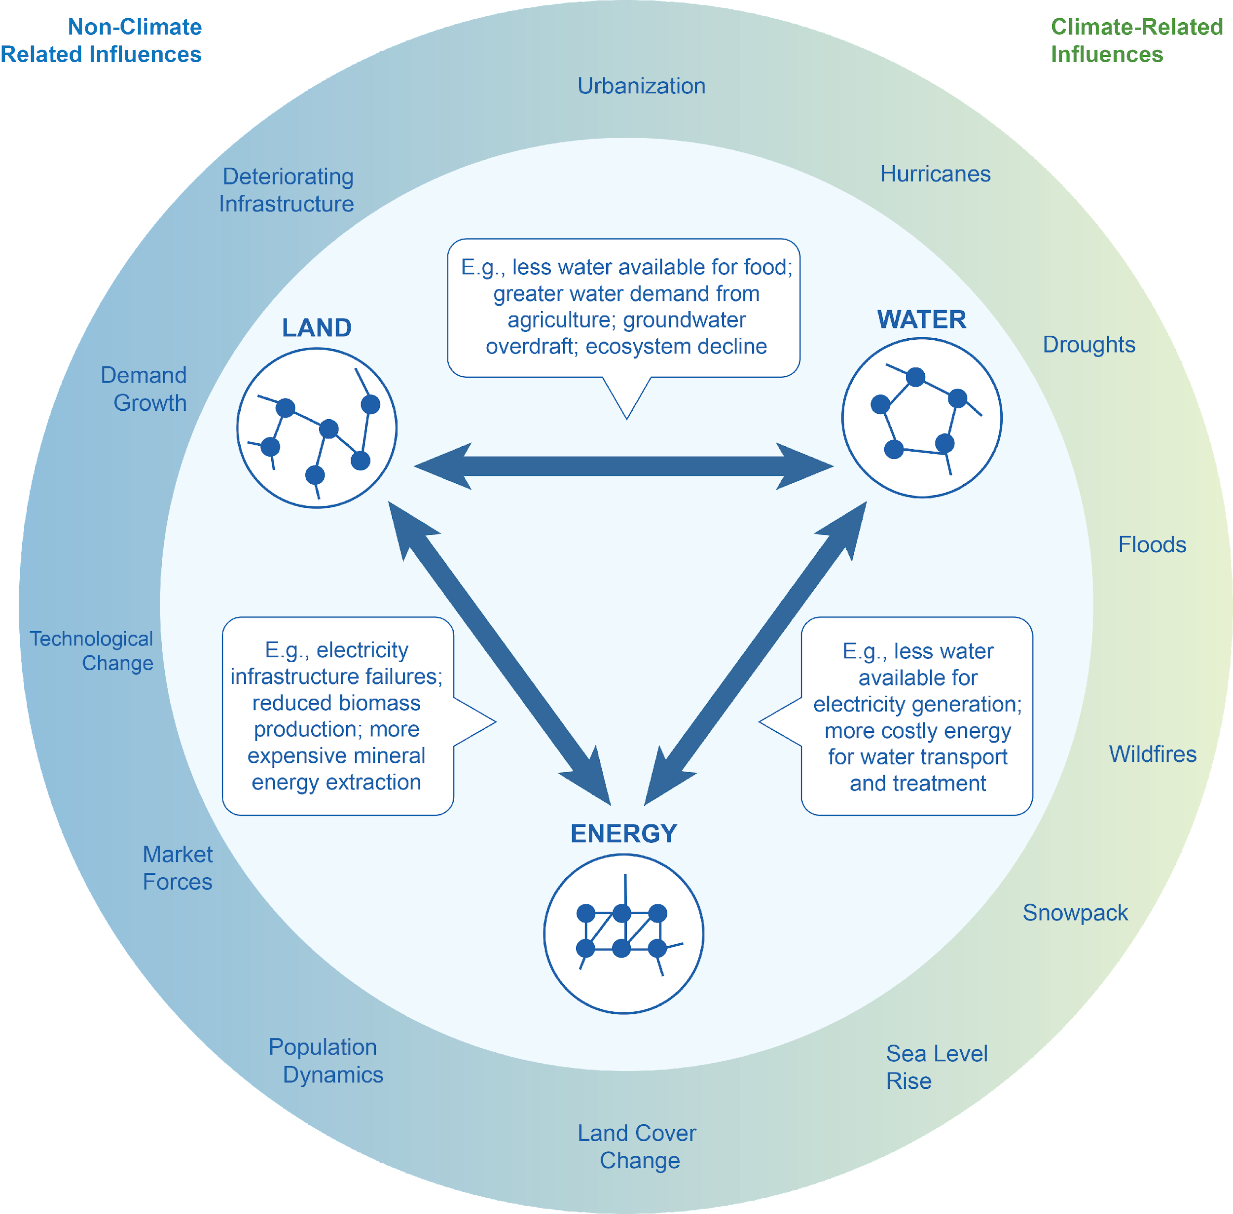
Some Examples of Complex Sectoral Interactions Involving Water
Population grows, demanding more energy, land for food, and water for the food and energy
Humans produce more emissions, which alter climate, resulting in altered water availability and increasing energy system requirements
Tensions across water users (agriculture and energy) occur, requiring coordinated planning
Source: Clarke et al. (2018)

Slide 30
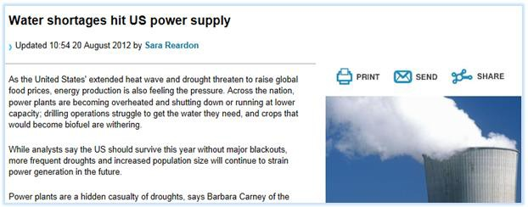
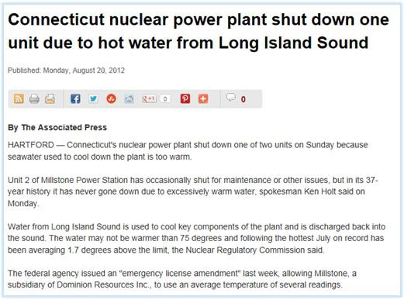
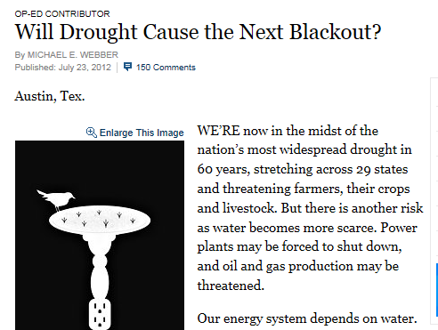
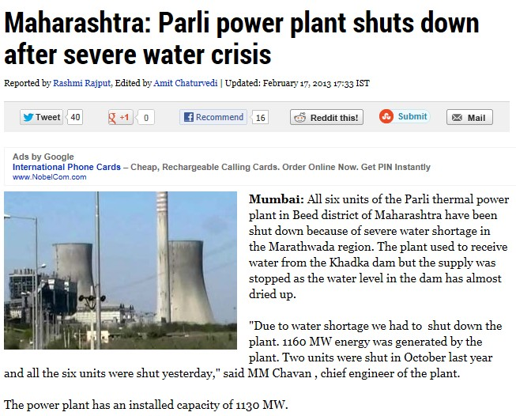
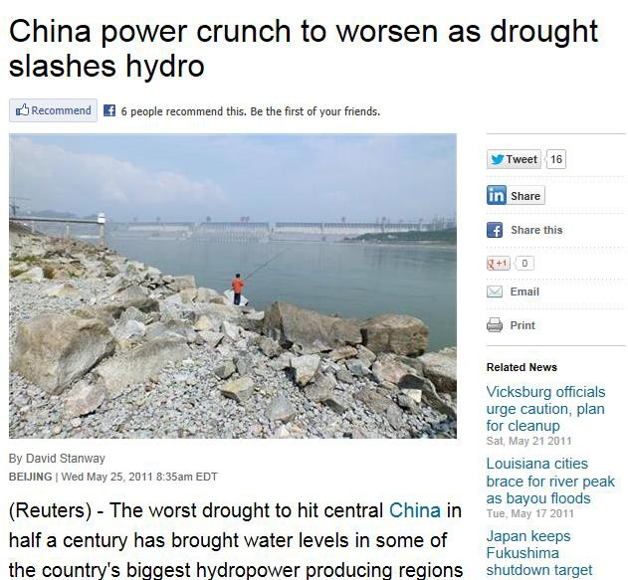

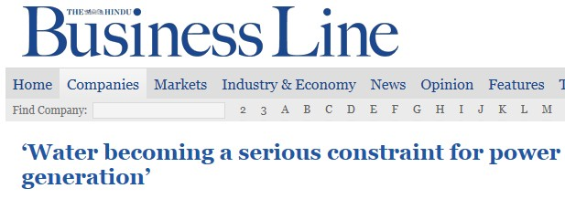

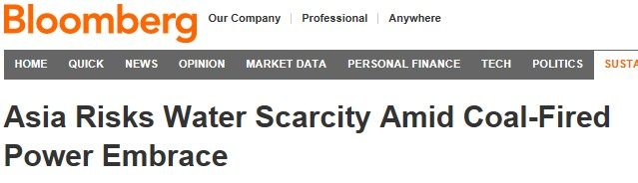

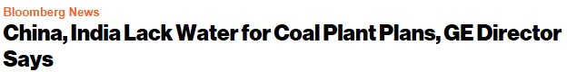
The water scarcity challenge is already present and very real

Slide 31
How and Why do models include water?
Water is a potential constraint to economy, energy, and land growth
Many models (e.g., GCAM) only included water within the last 5-10 years or so
Water demand/supply/allocation vary across models
Water supplies and demands are represented in economic terms
Water supply (stocks, flows, costs) is handled via existing, detailed global surface and groundwater hydrology models that provide external (exogenous) inputs
Water demand is handled internally, being linked to economic factors
Model | Home Institution | Hydrologic model
AIM Asia Integrated Model | National Institutes for Environmental Studies, Tsukuba Japan | H08
GCAM Global Change Analysis Model | Joint Global Change Research Institute, PNNL, College Park, MD | Xanthos
IGSM Integrated Global System Model | Joint Program, MIT, Cambridge, MA | CLM-WSM
IMAGE The Integrated Model to Assess the Global Environment | PBL Netherlands Environmental Assessment Agency, Bildhoven, The Netherlands | LPJmL
MESSAGE Model for Energy Supply Strategy Alternatives and their General Environmental Impact | International Institute for Applied Systems Analysis; Laxenburg, Austria | GLOBIOM
REMIND Regionalized Model of Investments and Technological Development | Potsdam Institute for Climate Impacts Research; Potsdam, Germany | LPJmL

Slide 32
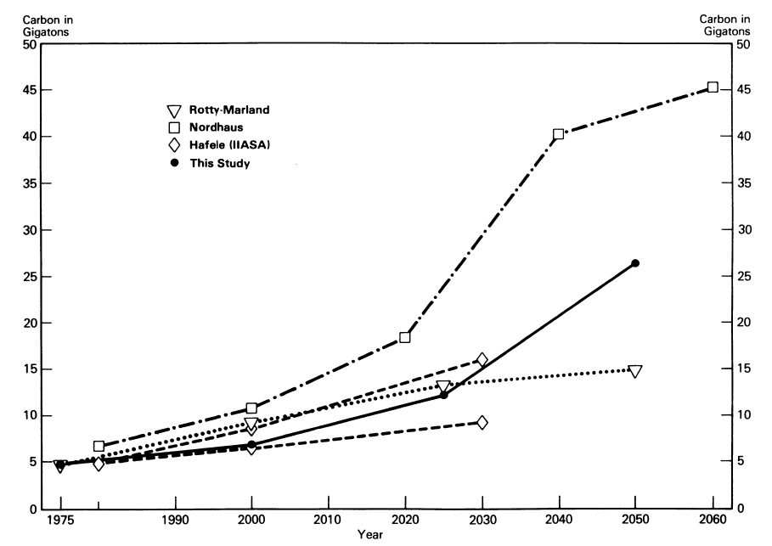
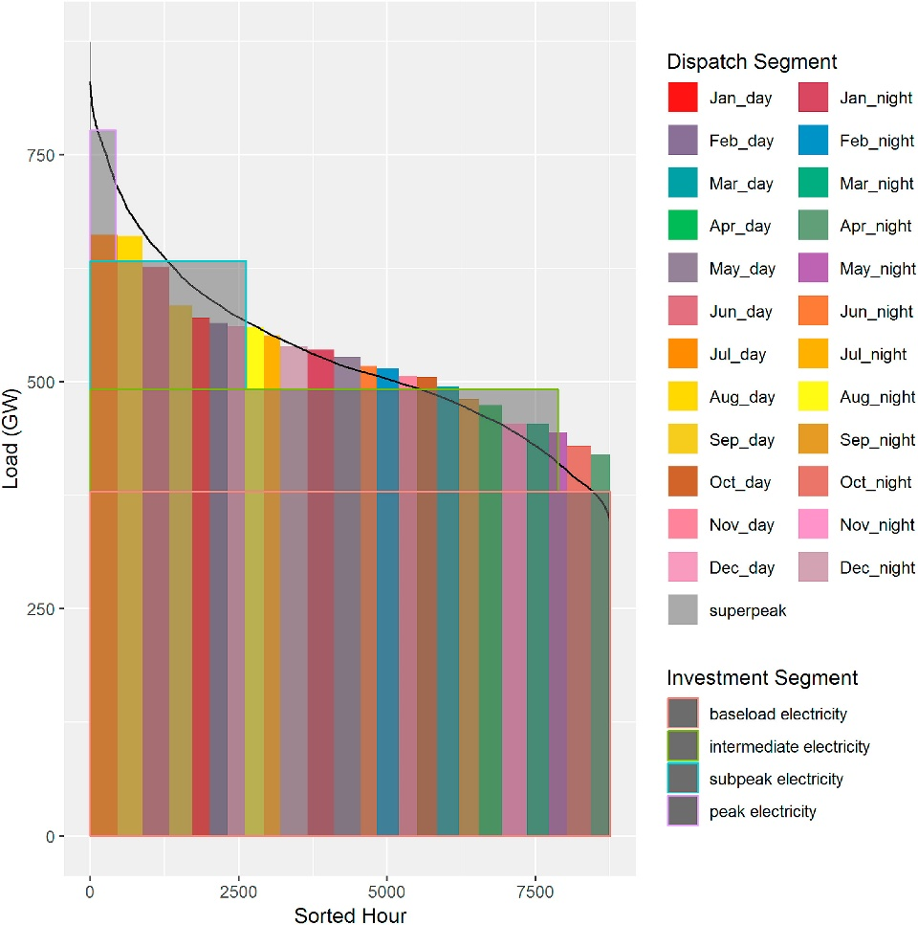
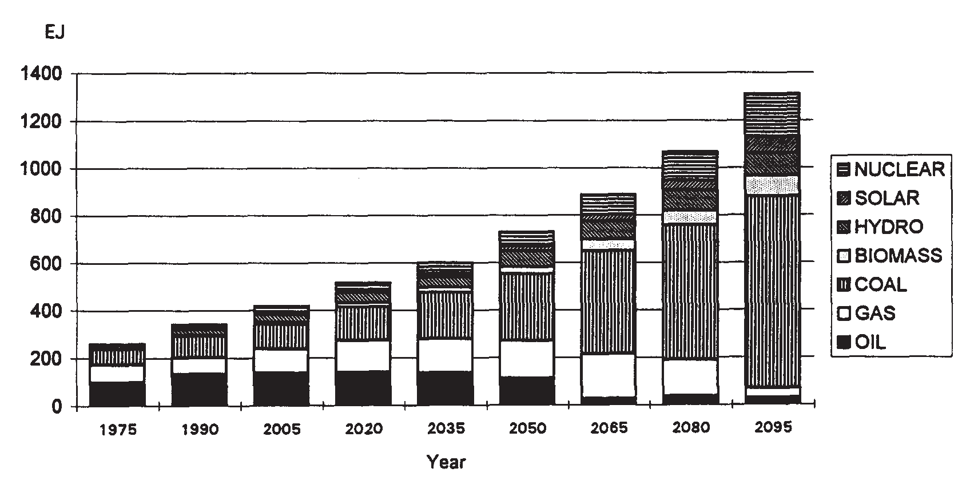
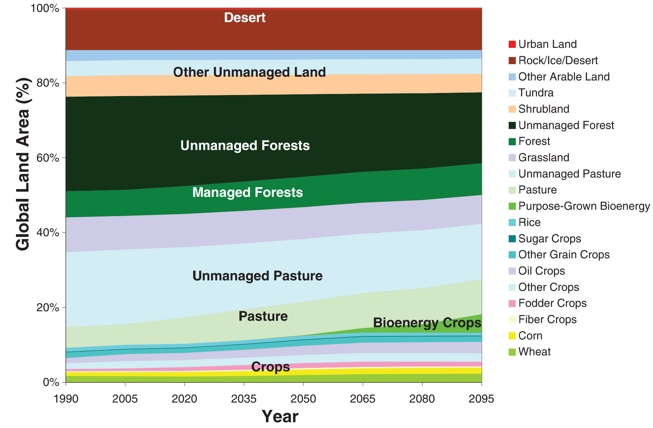
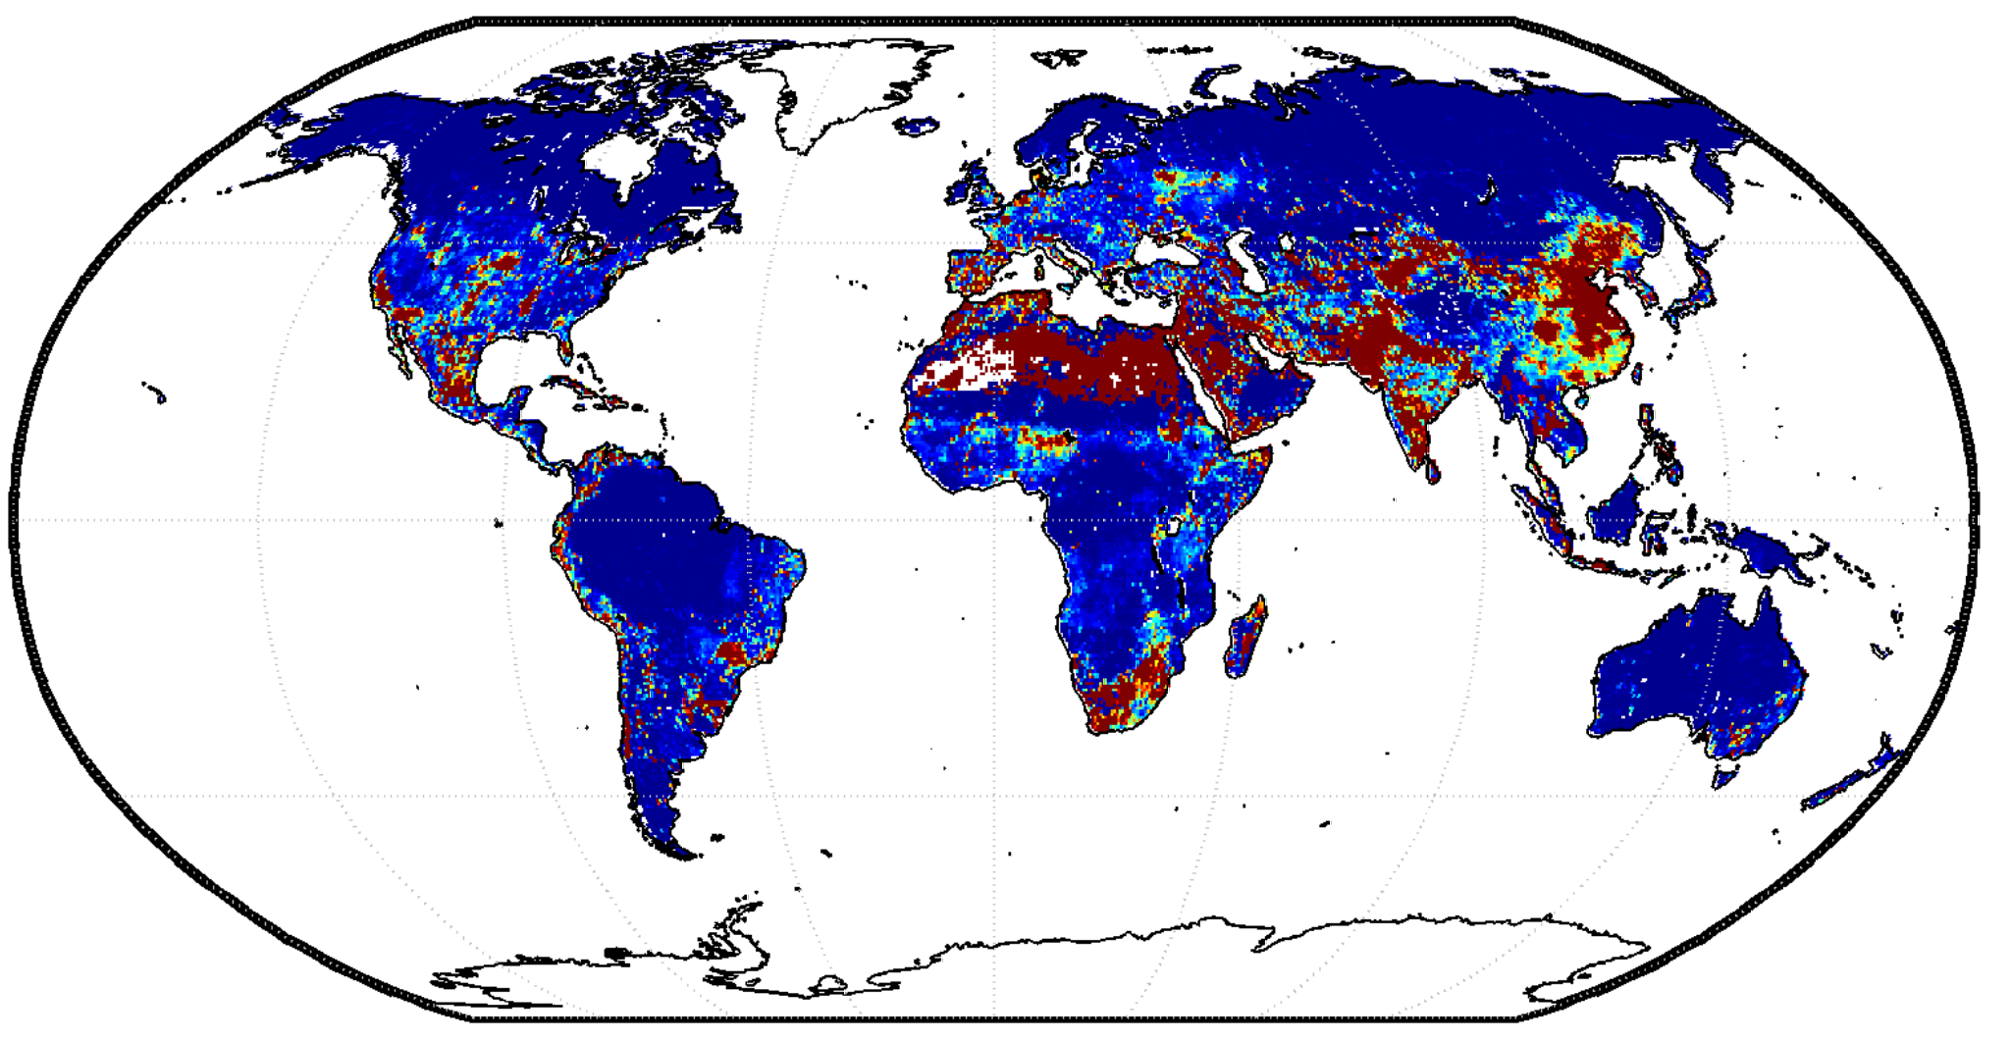
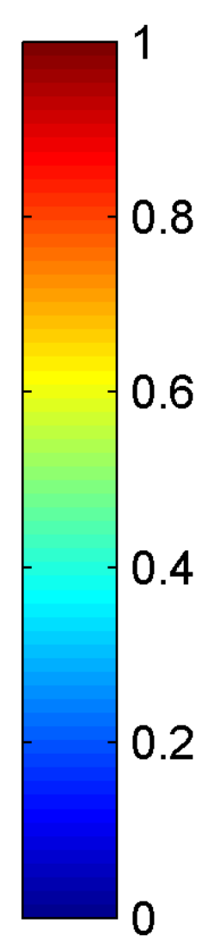
The Evolution of GCAM Research
1980s
Projections of emissions and concentrations
Understanding the complex interactions among energy, water, land, climate, socioeconomics, and other important human and natural systems at regional to global scales
2015–Present
Integrating impacts
Edmonds and Reilly (1983). The Energy Journal.
Wise et al. (2019). ESR.
1990s
2010s
Energy and Technology
2000s
Water system
Land use system
Water Scarcity Index
Edmonds et al. (1995).
Energy Policy.
Wise et al. (2009).
Science.
Hejazi et al. (2014). HESS.
ENERGY-ECONOMY-CLIMATE
ENERGY-ECONOMY-LAND-CLIMATE
ENERGY-ECONOMY-LAND-WATER-CLIMATE

Slide 33
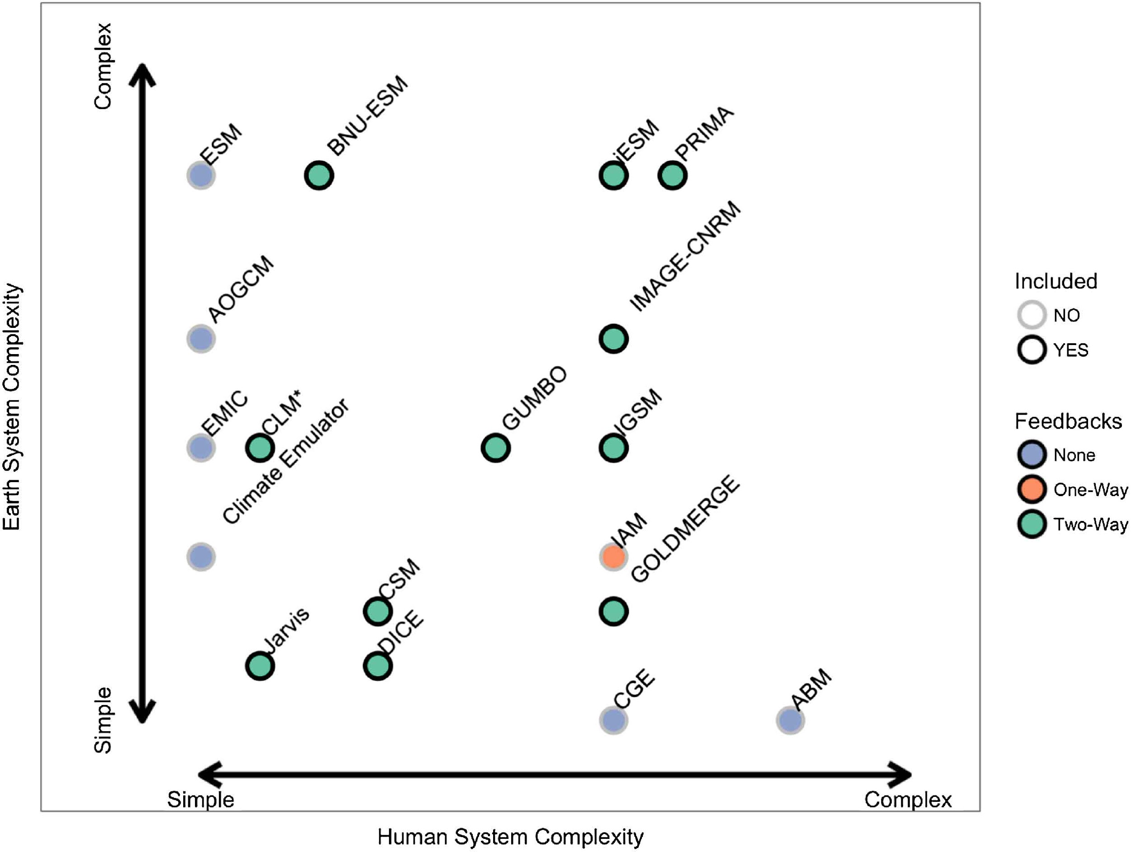
We do not typically account for two-way feedbacks. Instead, we feed climate impacts on water supply one-way.
GCAM Approach to Climate Impacts on Water Supply
GCAM
Simple climate model
Earth System Model (ESM)
Energy, Economy, Land
Water
External Global Hydrology Model
Demand
Supply
Calvin and Bond Lamberty (2018), ERL

Slide 34
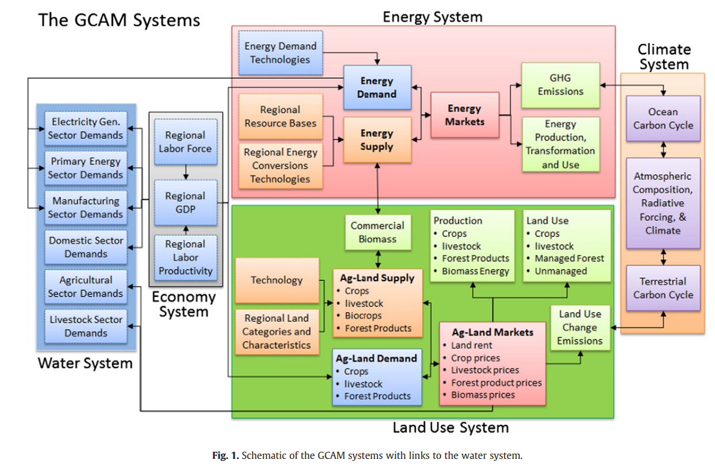

Slide 35
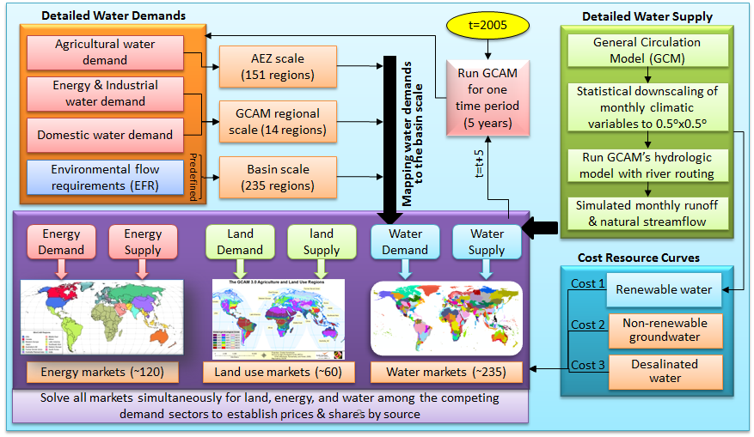
Schematic of the overall market-based approach across all goods and services in GCAM
Not currently designed to capture sub-annual dynamics, though many models are pushing to finer time scale (e.g., 1 year).

Slide 36
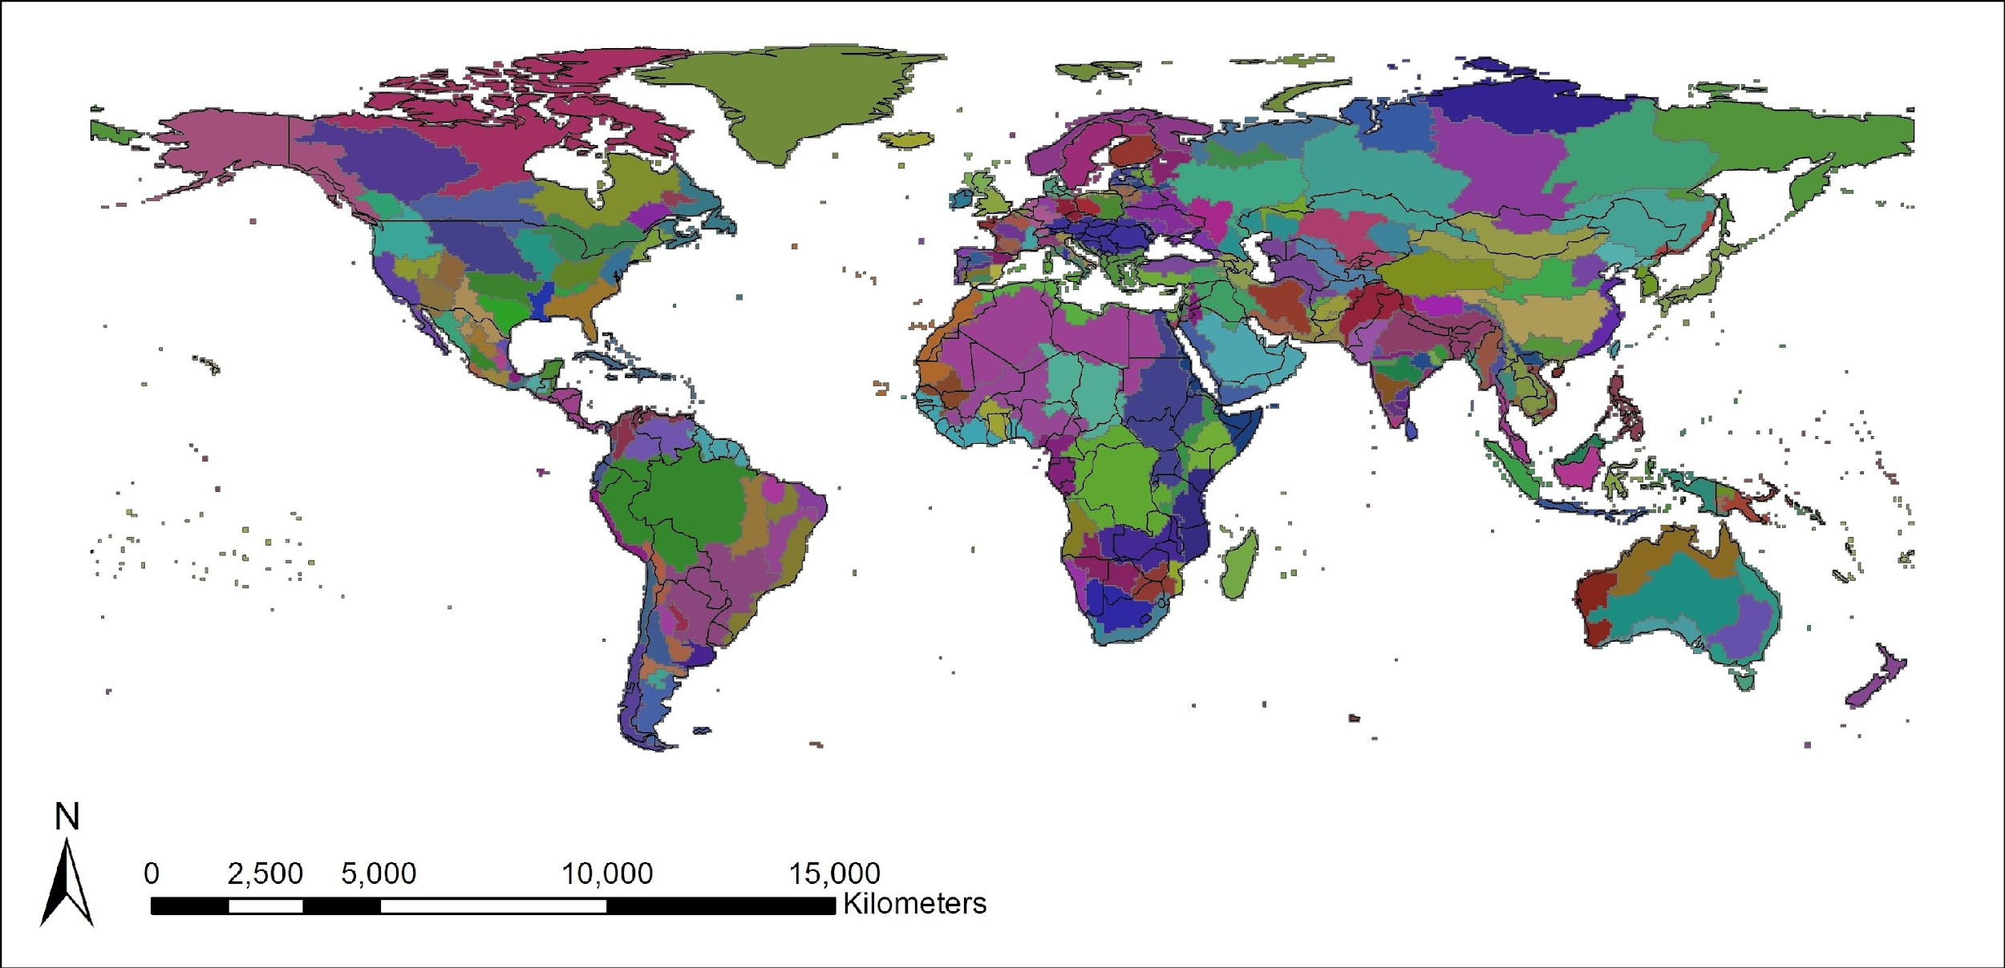
GCAM hydrological regions in the GCAM Core
Core GCAM tracks balances water supply and demand in 235 hydrological regions (not exactly basins)

Slide 37
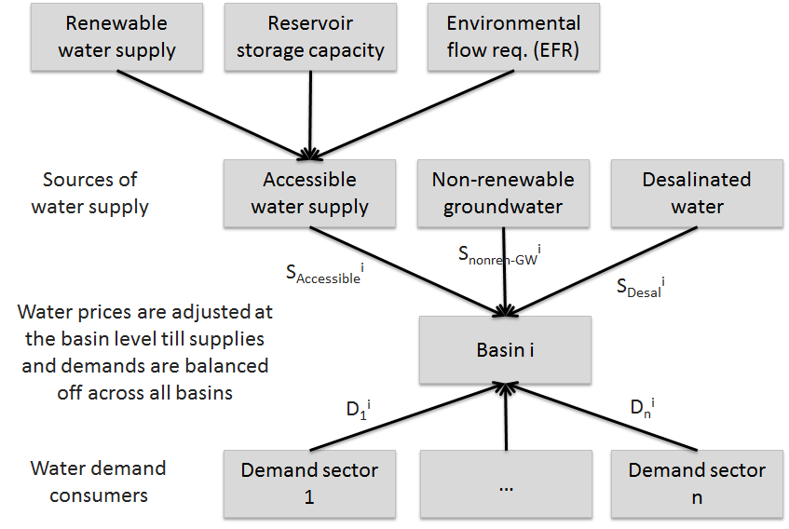
Schematic of the water allocation mechanism at the basin scale in GCAM

Slide 38
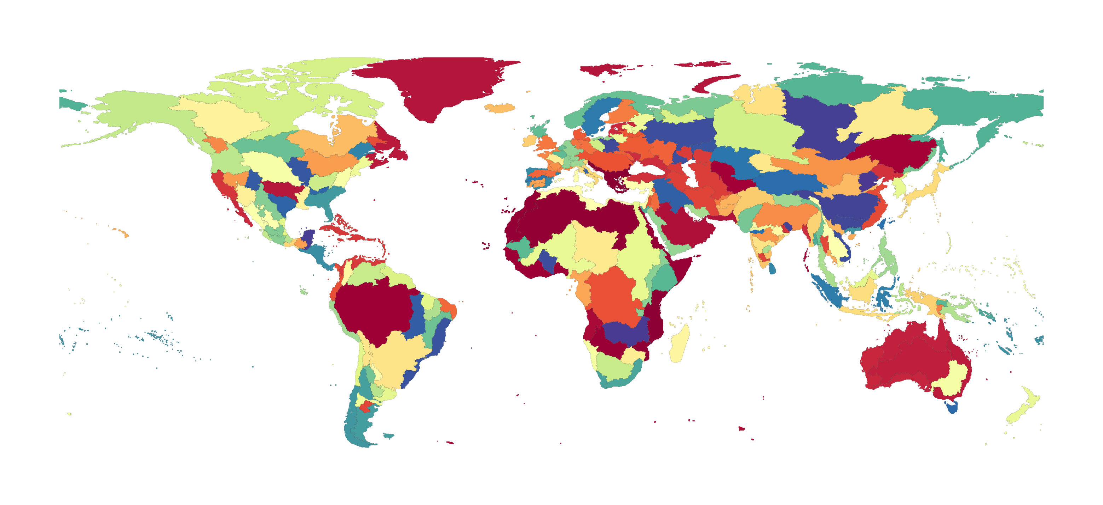
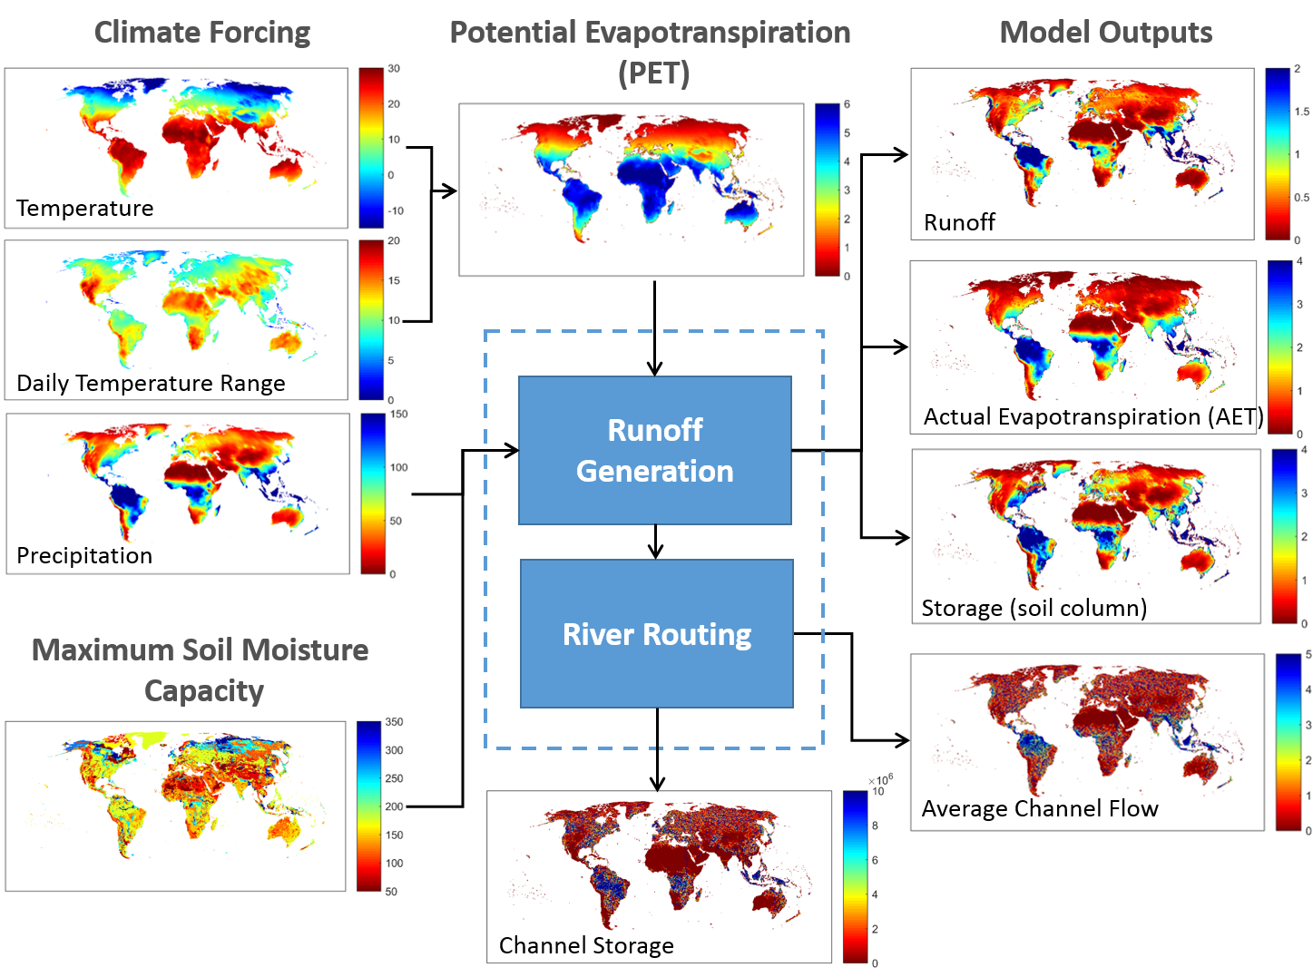
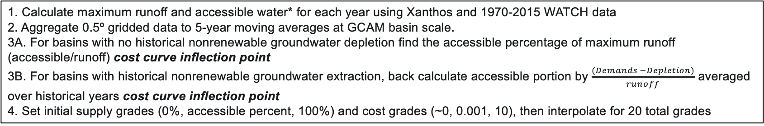
Surface water supply and cost curves in GCAM
Xanthos Processing
235 GCAM Basins
Price $
Price $
Availability [%]
Availability [%]
1. Calculate maximum runoff and accessible water* for each year using Xanthos and 1970-2015 WATCH data
2. Aggregate 0.5º gridded data to 5-year moving averages at GCAM basin scale.
3A. For basins with no historical nonrenewable groundwater depletion find the accessible percentage of maximum runoff (accessible/runoff) cost curve inflection point
3B. For basins with historical nonrenewable groundwater extraction, back calculate accessible portion by $\frac{(Demands −Depletion)}{runoff}$ averaged over historical years cost curve inflection point
4. Set initial supply grades (0%, accessible percent, 100%) and cost grades (~0, 0.001, 10), then interpolate for 20 total grades

Slide 39
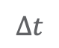
Groundwater supply and cost curves in GCAM
Derived unit cost of groundwater extraction over time at 50km grid cells
Estimates of groundwater availability from previous studies on porosity, depth-to-groundwater, and aquifer thickness in addition to WHYMAP
Constrained to only allow for 25% use of all physical water estimated in aquifer
Calculations within require an assumption of confined aquifer, however results assumed to be from unconfined aquifer
Increasing Cost
$$∆t$$
Price $
Cost Grade
Aggregate unit costs at 50km grid to GCAM basin scale and transform into 24 unique cost grades
Historical groundwater depletion from WaterGap is placed into grade_hist which is pulled during historical calibration
Added to GCAM as a subresource with price interactions with renewable water cost curves.

Slide 40
Surface water and Groundwater price interaction
Renewable cost curve
Basin A
Groundwater cost curve
Basin A
Water withdrawals come from cheap renewable sources first.
If demands exceed the accessible portion in any given timestep, a price interaction between groundwater and renewable water occurs where water is drawn from the cheaper source first.
Price $
Price $
Availability [%]
Cost Grade
Price $
Price $
Availability [%]
Cost Grade

Slide 41
Surface water and Groundwater price interaction
Renewable cost curve
Basin A
Groundwater cost curve
Basin A
Water withdrawals come from cheap renewable sources first.
If demands exceed the accessible portion in any given timestep, a price interaction between groundwater and renewable water occurs where water is drawn from the cheaper source first.
As groundwater is exhausted in low-cost grades, the point of interaction between renewable and groundwater is pushed to higher prices
More water than is deemed accessible must be pulled in order to start the price interaction with groundwater
Price $
Price $
Availability [%]
Cost Grade
Price $
Price $
Availability [%]
Cost Grade

Slide 42
Exciting (Water-Related) Science Questions IAMs are Exploring
What key insights have emerged from IAMs?
What questions remain unanswered?

Slide 43
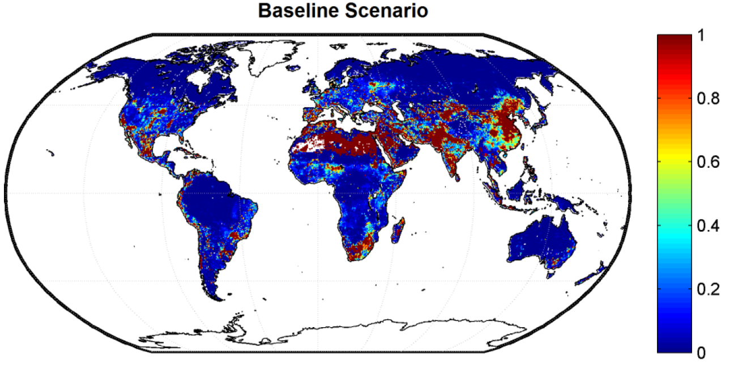
Where will future water scarcity occur and worsen?
Hotspots with exacerbating water scarcity conditions in year 2100
Water scarce regions will face worsening conditions
Hejazi M, J Edmonds, L Clarke, P Kyle, E Davies, V Chaturvedi, M Wise, P Patel, J Eom, K Calvin. 2014. “Integrated assessment of global water scarcity over the 21st century under multiple climate change mitigation policies.“ Hydrology and Earth System Sciences 18:2859-2883. DOI:10.5194/hess-18-2859-2014.

Slide 44
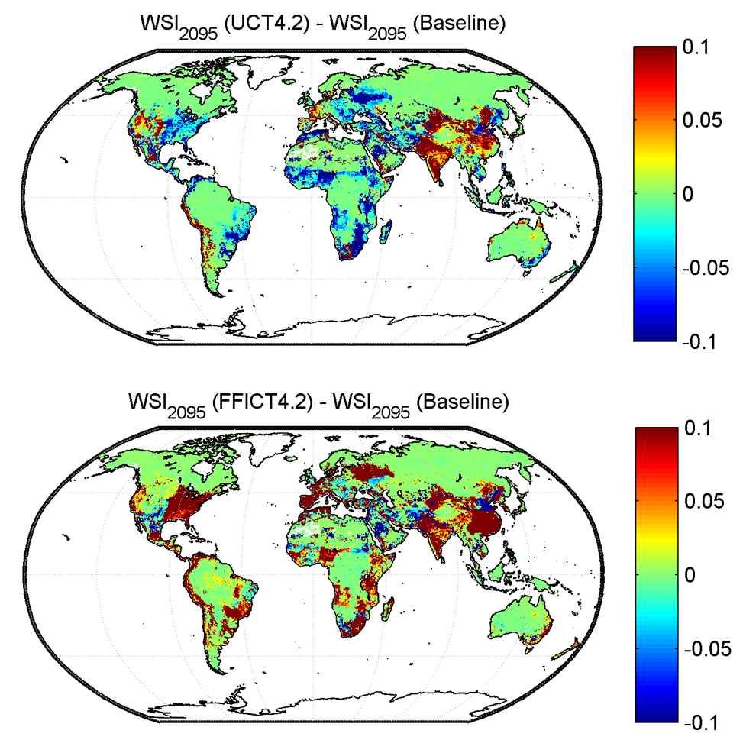
How will climate mitigation affect water scarcity?
ΔWSI₂₁₀₀(Policy –Reference)
Climate mitigation will affect water scarcity
The type of climate policy and stringency of target matter
Climate mitigation will generally alleviate water scarcity. But, policies favoring bio-energy will exacerbate water scarcity
Location matters – there are winners and losers
UCT4.2
Δpop = -3.6%
ΔWSI₂₁₀₀(Policy –Reference)
Hejazi et al. 2014. “Integrated assessment of global water scarcity over the 21st century under multiple climate change mitigation policies.“ Hydrology & Earth Sys. Sc. 18:2859-2883.
FFICT4.2
Δpop = +8.4%

Slide 45
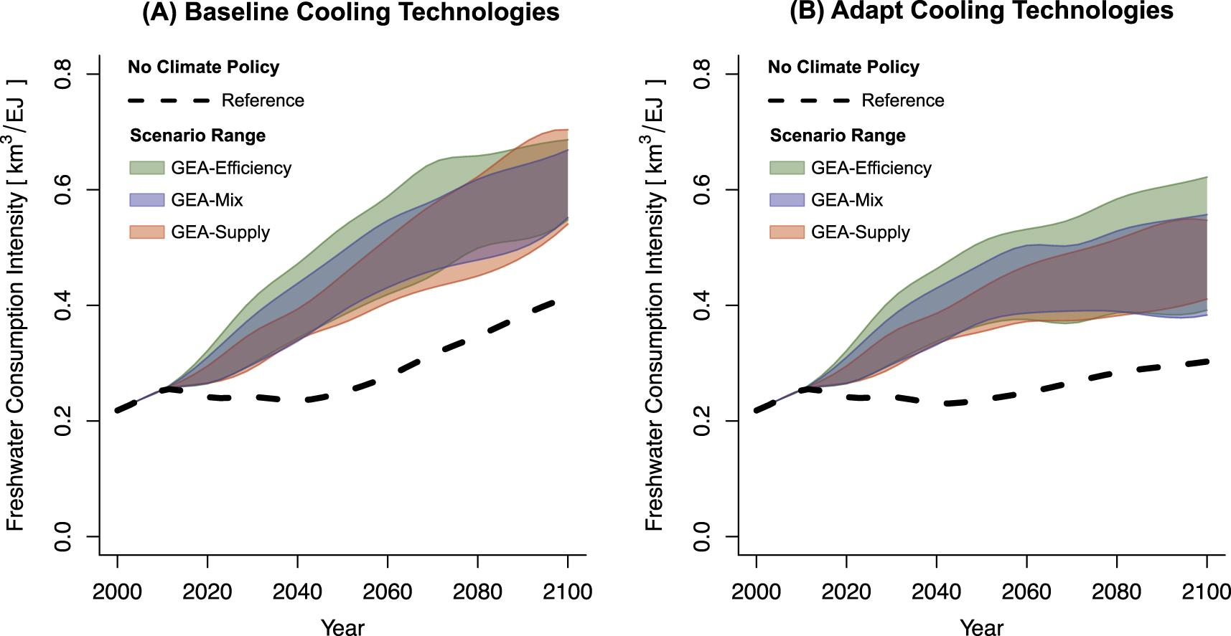
What are the water sector implications of the energy transitions required to implement climate policy (e.g., 2°C)?
Achieving 2 °C will require increased cooling water usage (relative to Reference scenario) due to increasing electricity demand
Adapting cooling technologies can help reduce demands
Reducing energy demands, emerges as a key strategy to limit water usage, which underscores the importance of an integrated (i.e., IAM) approach
Fricko et al. (2018), ERL

Slide 46

Will human activities (water demands) or climate change impacts be the key driver of changes in water scarcity?
Humans Drive Future Water Scarcity Changes Across all Shared Socioeconomic Pathways
Graham et al. (2020), ERL

Slide 47



Groundwater constraints reduce total consumption and hasten peak withdrawal
Unconstrained groundwater Constrained groundwater
GCAM result
Wada et al. (2014)
Turner, S. W., et al. (2019). Influence of groundwater extraction costs and resource depletion limits on simulated global nonrenewable water withdrawals over the twenty‐first century. Earth's Future, 7(2), 123-135.

Slide 48


Biggest impacts on irrigated agriculture and electricity generation
Unconstrained groundwater
Constrained groundwater
Turner, S. W., et al. (2019). Influence of groundwater extraction costs and resource depletion limits on simulated global nonrenewable water withdrawals over the twenty‐first century. Earth's Future, 7(2), 123-135.
March 5, 2018
16

Slide 49


Production of irrigated crops moves elsewhere…
Turner, S. W., et al. (2019). A pathway of global food supply adaptation in a world with increasingly constrained groundwater. Sci. Tot. Env., 673, 165-176.
Impact of groundwater
constraints (year 2100)
-90
0
+90 Mt

Slide 50

… and rain fed crops comprise a larger share of production
Turner, S. W., et al. (2019). A pathway of global food supply adaptation in a world with increasingly constrained groundwater. Sci. Tot. Env., 673, 165-176.
Impact of groundwater
constraints (year 2100)
-90
0
+90 Mt
March 5, 2018
18

Slide 51

Middle East, India, Pakistan lose out, while US sees net production loss
Turner, S. W., et al. (2019). A pathway of global food supply adaptation in a world with increasingly constrained groundwater. Sci. Tot. Env., 673, 165-176.
March 5, 2018
19

Slide 52

Responses to constraints often occur across different systems
Different strategies are taken in response to water constraints, which is robust across alternate scenarios
Cui et al. 2018. ERL

Slide 53
Summary
Water is a key input (and potential constraint) to agricultural and industry and thus their emissions, which is a key reason Integrated Human-Earth System Models include water
Humans have altered the water cycle through water usage, climate change, and land use change
In turn, climate change is likely to increase extreme events, which Integrated Models have trouble handling
Humans (i.e., demands) will play a critical role in the future of water withdrawals and scarcity
Integrated Human-Earth System Models have addressed questions about the future, such as:
How will future water scarcity evolve in the future?
What does climate policy mean for water?
Can the human system adapt to water shortages via agricultural trade and transformed cooling options?
What will be the relative usage of groundwater vs. surface water vs. desal in meeting future demands?

Slide 54





























Future Challenges to Address in Modeling Water in IAMs
Model evaluation over history (e.g., 1975- 2010) is a prerequisite to publish water modeling results
Water use at sub-annual scale or even at annual scale is hardly available
Mapping between geopolitical regions, AEZs, and river basins
Time period in IAMs is too coarse to capture the inter- & intra- variability in water
Limited to the 4 RCPs for which there exists GCM simulations
The ability to store water (reservoirs) and reuse water
GCM outputs come at various spatial units and require downscaling and bias-correction
The impact of climate changes on water demands, and hydropower
Developing resource curves for the various sources of water and their historical use
The role of adaptation (irrig., cooling tech). How quickly can adaptation come in the future?
Water regulations are heterogeneous and water allocation are often not based on markets
Water is heavily subsidized in many regions and different sectors face different water prices
How much gw water is available and how much has already been depleted?
Energy use associated with extraction and treatment of
water ³

